Slide 1
Causes of the Revolution

Slide 2
Review so far:
French and Indian War
Proclamation of 1763
Sugar Act (George Grenville) – tax on molasses. Smuggle anyway.
Stamp Act (George Grenville) – tax on paper/documents
“No taxation without representation!”

Slide 3
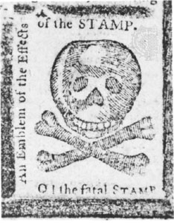
Moving Toward Unity
Delegates from nine colonies meet in New York City
Called “Stamp Act Congress”
Wrote a petition to King George III and Parliament
Say that Parliament has no right to tax colonists
Parliament pays little attention.
Petition: a formal written request to
someone in authority.

Slide 4
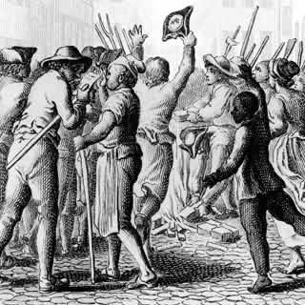
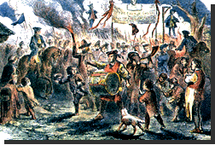
Boycott
Next, colonists decide to boycott British goods.
This did hurt British trade.
Fell by 14%
British merchants and workers suffered
Boycott: to refuse to buy certain goods
and services.

Slide 5
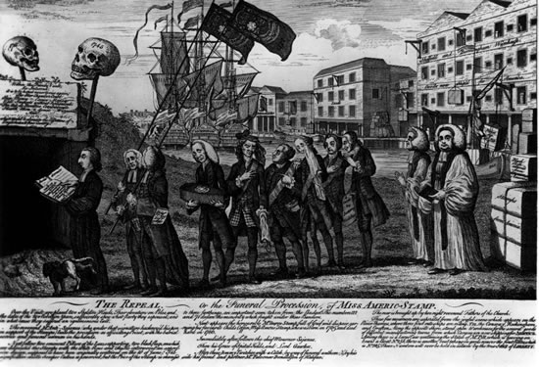
Repeal
Parliament finally repealed (canceled) the Stamp Act.
But it passed a law saying that Parliament had the right to raise taxes in “all cases whatsoever.”
Repeal: cancel,
get rid of

Slide 6
The Townshend Acts
In 1767, George Grenville challenged Charles Townshend, the official in charge of the British treasury.
Parliament soon passed the Townshend Acts.
Taxed goods such as glass, paper, paint, lead, and tea.
Taxes were low, but it was the principle that made the colonists angry.
“No taxation without representation!”

Slide 7
The Townshend Acts
They also set up new ways to collect taxes.
Trying to stop smuggling, they sent customs officials who could inspect a ship’s cargo without reason. They just needed to have a writs of assistance.
Colonists said that these writs of assistance violated their rights as British citizens.
Under British law, an official could not search a person’s property without a good reason for suspecting the owner of a crime.

Slide 8
More Protests
Colonial merchants and planters from north to south signed nonimportation agreements.
In these agreements they promised to stop importing goods taxed by the Townshend Acts.
They hoped the boycott would urge the repeal of the acts.

Slide 9
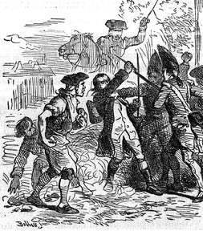
Sons of Liberty
To protest British policies, some angry colonists formed the Sons of Liberty.
They would stage mock hangings or burnings of cloth or straw effigies dressed like British officials.
This was supposed to show tax collectors what might happen to them if they tried to collect the unpopular taxes.

Slide 10
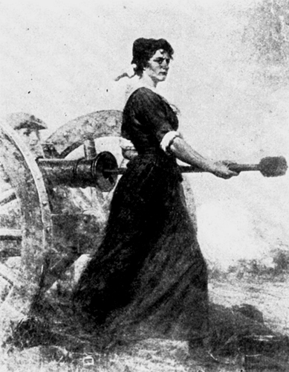
Daughters of Liberty
They paraded, signed petitions,
and organized a boycott of fine
British cloth.
“It is better to wear a Homespun
coat than to lose our Liberty.”
Both the Sons and the Daughters
of Liberty would visit merchants
and urge them to sign the
nonimportation agreements.
Some even threatened people
who continued to buy British goods.

Slide 11
Boston Massacre
March 5, 1770
Colonists throwing snow, ice, rocks, and insults at the British soldiers
Soldiers panic and fire into the crowd
5 colonists killed, several injured
Crispus Attucks among the first to die, a black sailor who was active in the Sons of Liberty

Slide 12
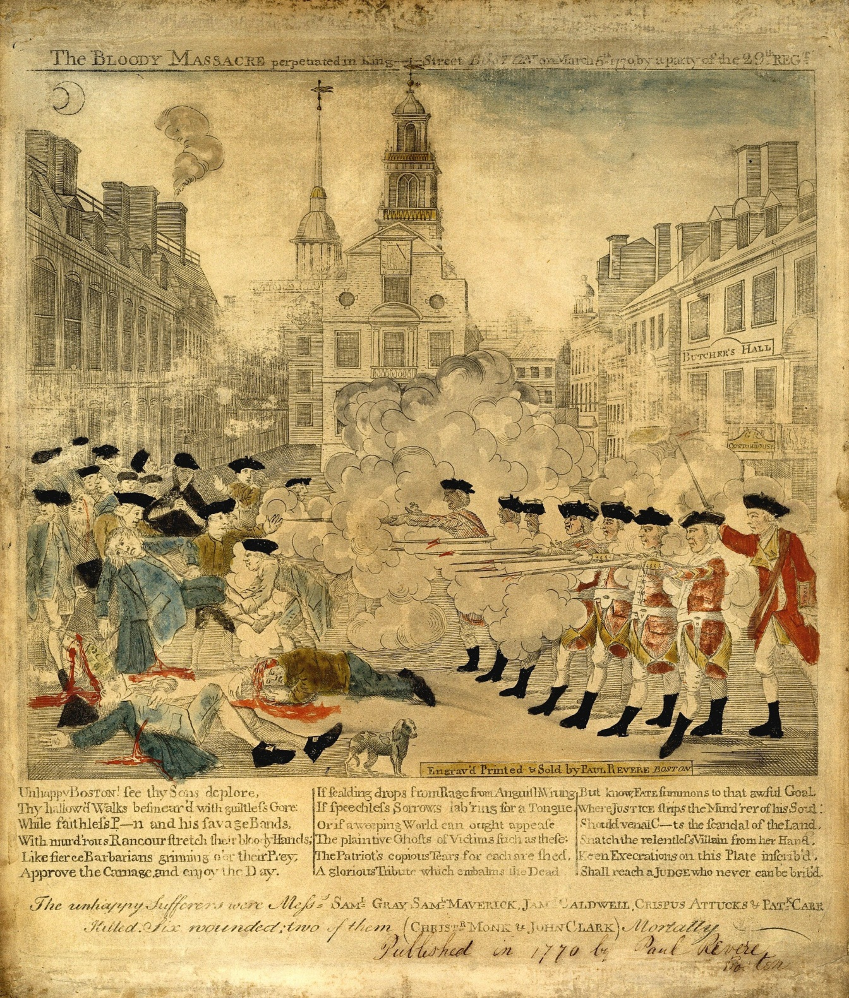

Slide 13
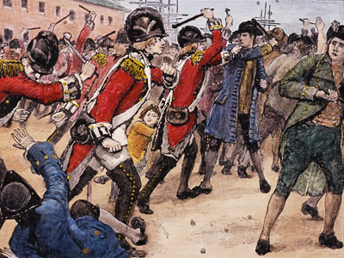
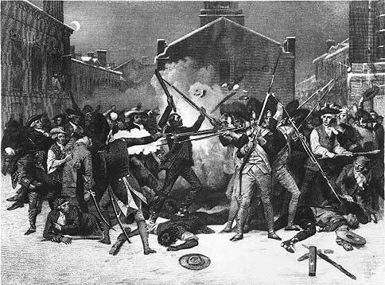

Slide 14
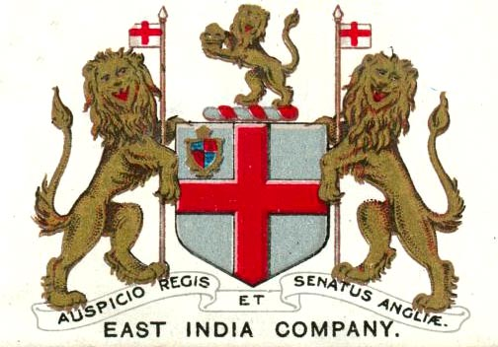
Tea Time!
Tea was very popular
By 1770, at least one
million Americans brewed
tea twice a day. Many
would claim to rather go
without dinner.
Most tea brought to America by the British East India Company.
The company was in big financial trouble in the 1770s.
Why? Because Britain had a tax on tea that the colonists resented. They refused to buy the tea.
Buy low…sell high

Slide 15
The fuse is getting smaller…
Parliament tried to help the East India Company by passing the Tea Act in 1773.
This allowed the company to bypass merchants and sell directly to colonists.
Colonists still had to pay the tea tax, but they did not have to pay the higher price the merchants would ask for.
Tea would actually cost less than ever before!
Everyone got mad.

Slide 16
I’m not drinking tea! I’m drinking coffee!
Merchants were angry because they had been cut out of the trade.
If Parliament ruined tea merchants today, who would they ruin tomorrow?
Everyone else was angry because they thought that Britain was just trying to trick them into paying the taxes and accepting that Britain had the right to tax the colonies.
Was this what Britain was trying to do?

Slide 17
A New Boycott
“Do not suffer yourself to sip the accursed, dutied STUFF. For if you do, the devil will immediately enter into you, and you will instantly become a traitor to your country.”
-A colonial newspaper
At some ports, Sons of Liberty wouldn’t even let the British East India Company unload their cargo.

Slide 18
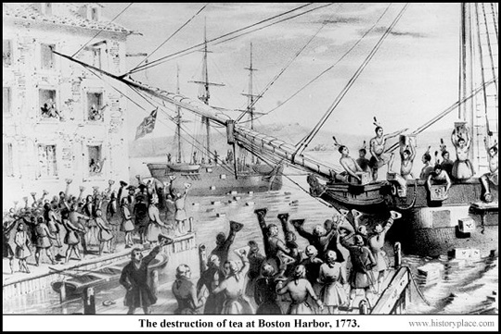
Boston Tea Party
3 ships entered Boston harbor in late November 1773.
Sam Adams and the Sons of Liberty were determined not to let it unload.
A group of colonists dressed as Mohawk Indians boarded the ships, opened the tea chests, and dumped them into the harbor.
It was a full moon, and it was over by 10 o’clock.

Slide 19
Some colonists cheered the Boston Tea Party, others were worried about Britain’s reaction, but what Britain did shocked everyone.
The British were outraged, and saw the Tea Party as an act of lawless behavior.
In 1774, Parliament, encouraged by King George III, enacted four acts to punish Boston.
The colonists would call these acts “The Intolerable Acts”.

Slide 20
This is intolerable! – The Intolerable Acts
Britain shut down the port in Boston
Massachusetts colonists were forbidden to hold town meetings more than once a year without the governor’s permission.
In the past, colonists had called for town meetings whenever they wished.
Parliament provided for customs officers and other officials charged with major crimes to be tried in Britain instead of Massachusetts.
Parliament passed a new Quartering Act.
British commanders could force citizens to house troops in their homes.

Slide 21
We will support you Boston!
Committees of Correspondence spread the news of the Intolerable Acts.
House of Burgesses sets day aside to mark the shame of the Intolerable Acts.
September 1774: Colonial leaders from 12 colonies meet in Philadelphia.
Only Georgia did not send delegates
This was called the “First Continental Congress”.
They agreed to support Boston.

Slide 22
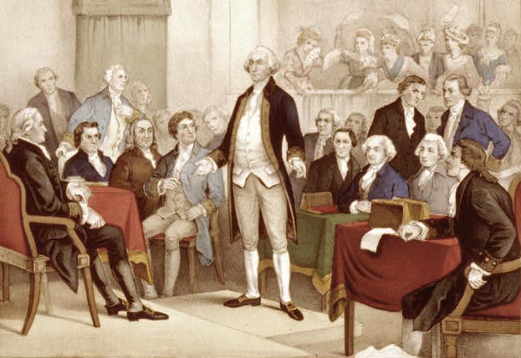
The First Continental Congress
Support Boston
Boycott all British goods
Stop exporting goods to Britain until Acts repealed
Urged colonies to set up and train their own militias
Agreed to meet again in May 1775
Militia: an army of citizens
who serve as soldiers during an
emergency

