Slide 1
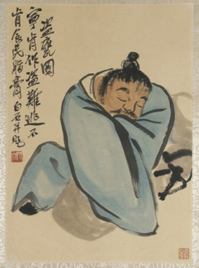
Chinese Dynasties and Their Achievements
Dynasties | Notable Rulers | Achievements
Xia Dynasty 2100-1800 B.C.E. | Aryans | Migrated into the area and conquered the local peoples Developed superior weaponry and technology
Shang Dynasty 1500-1100 B.C.E. | Thirty separate kings | Ruled from a succession of seven different capitals. Invention of writing
Zhou Dynasty 1122-256 B.C.E. | Kings + Noblemen | Expansion Regional rulers
Qin Dynasty 221-206 B.C.E. | Qin | Centralization of authority Written laws Building projects (Great Wall of China)
Han Dynasty | Han Wudi | 400 year rule Exploration (Zhang Qian) Expansion of trade Silk Road Pax Sinica Food reserves Merit-based appointments

Slide 2
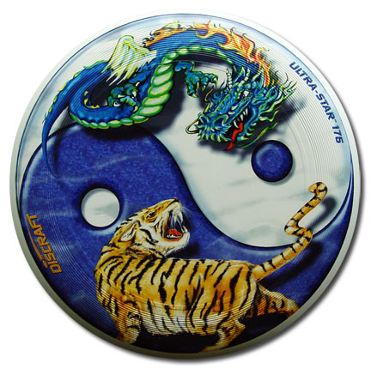
Chinese Philosophies/Religions
Philosophy/ Religion | Founders | Characteristics
Confucianism | Confucius (Kongzi) | Peace and order Respect for elders Ethical human relationships
Daoism | Laozi | Reject material things Commune with nature Become one with Dao (force within all things)
Buddhism | Budda | Four Noble Truths Eightfold path Nirvana Harmony with the universe

