Slide 1
Reconstruction and Westward Expansion
Outcome: End of Reconstruction

Slide 2
End of Reconstruction
End of Reconstruction
How did Reconstruction affect the people?
Many African Americans and poor white farmers became sharecroppers
Sharecropping: system where landowners divided their land and assigned households a few acres to work the land and keep a small share of the crops grown
Blacks win federal and state political office
Public schools and universities grow
Reconstruction ended with breakdown in Republican Party unity and a five year economic depression that began in 1873

Slide 3
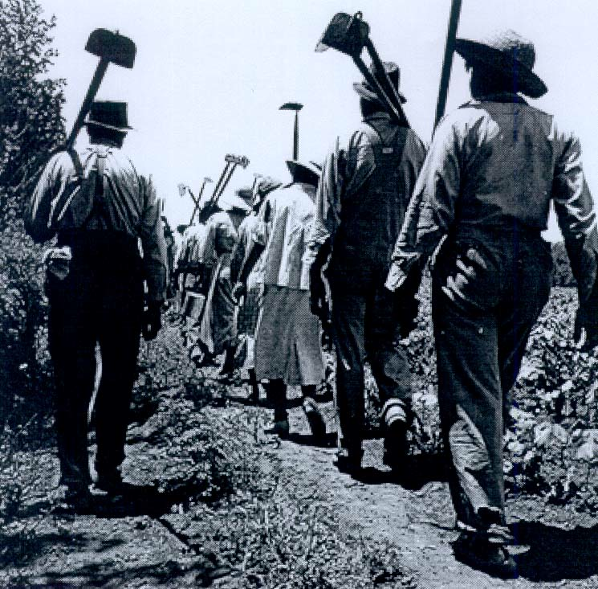
Sharecropping

Slide 4
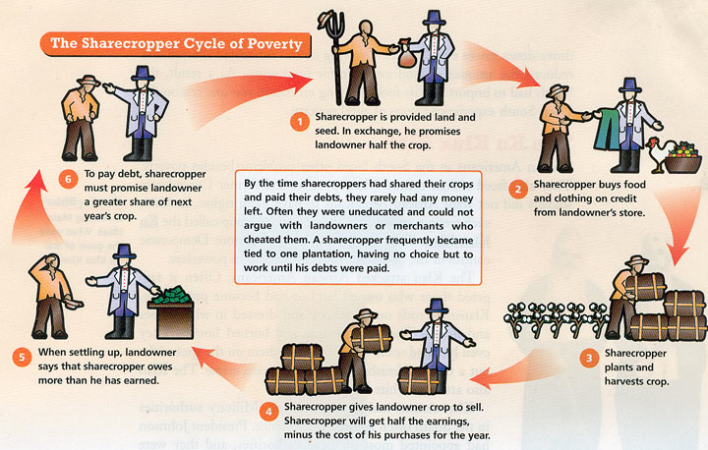
Sharecropping

Slide 5
End of Reconstruction
Compromise of 1877
Samuel Tilden defeats Rutherford B. Hayes in the election of 1876’s popular vote
Three disputed states lead to charges of fraud
Southerners agree to accept Hayes if he agrees to pull all federal troops from the South
Hayes becomes the 19th president of the United States

Slide 6
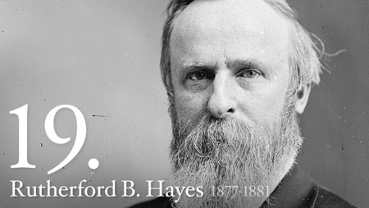
Rutherford B. Hayes

Slide 7
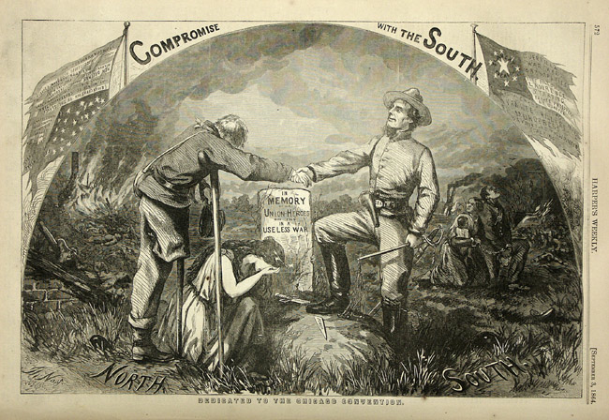
Compromise of 1877

Slide 8
End of Reconstruction
Without Federal troops in the South, Blacks were kept from voting by:
Intimidation
Poll Taxes which poor blacks couldn’t afford
Literacy Tests
Had to read and write to pass; Southern states once had laws against teaching slaves how to read or write, therefore, most blacks couldn’t read or write
Tests were more difficult for blacks
Grandfather Clause allowed poor, uneducated whites to vote

Slide 9
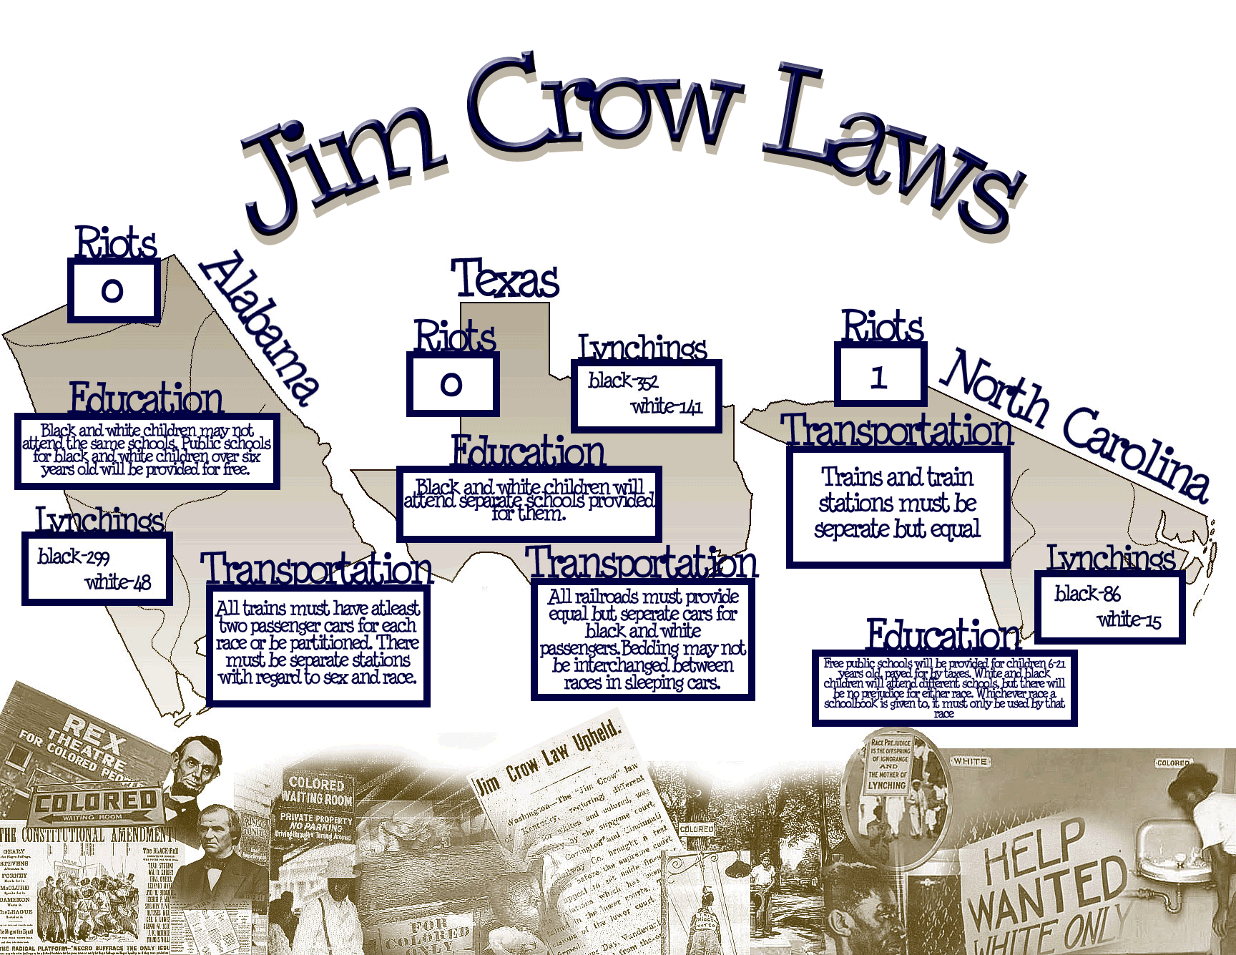

Slide 10
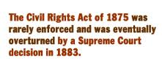
End of Reconstruction
The Civil Rights Cases & Plessy v. Ferguson
Civil Rights Cases of 1883
Southern business owners were refusing public services to blacks
US Supreme Court struck down the Civil Rights Act of 1875, saying that the 14th Amendment applied only to the states; Private citizens could now legally discriminate based on race

Slide 11
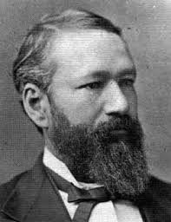
Homer Plessy

Slide 12
End of Reconstruction
Plessy v. Ferguson
Homer Plessy was 1/8th black and tried to sit in the white section of a train car; was arrested
US Supreme Court ruled that facilities could be separate as long as they were equal, thus establishing the “Separate but Equal” clause which allowed for legal segregation in the South

Slide 13
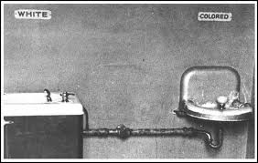
Separate but Equal?

Slide 14
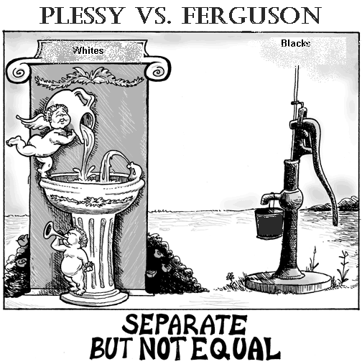

Slide 15
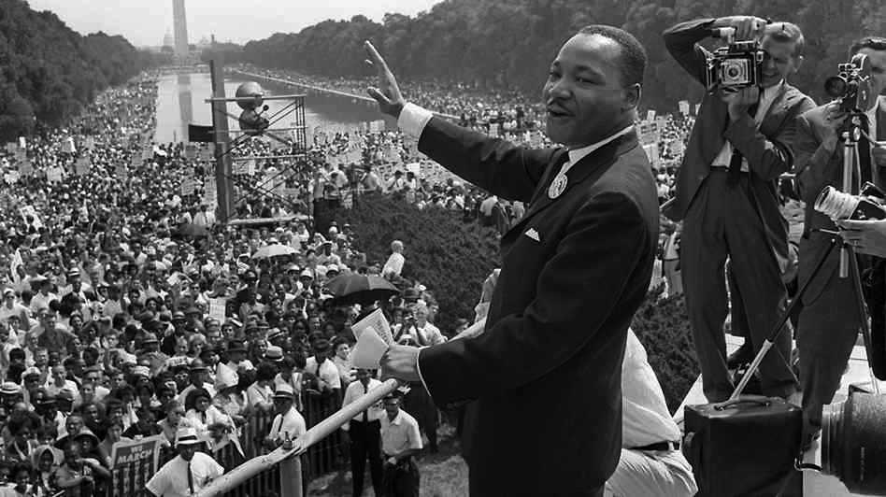
End of Reconstruction
Result: Even though Reconstruction was meant to bring the United States back together as one entity, the culture of the South and decisions made by the Supreme Court allowed for legal discrimination that would deny many Blacks rights that would eventually be fought for during the Civil Rights Movement of the 1960s and 1950s.

