Slide 1
Famous Emperors

Slide 2
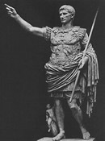
Augustus/Octavian
Caesar’s nephew
First emperor
Started era of peace and prosperity
Emphasized city improvements and the arts

Slide 3
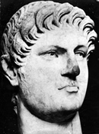
Nero
Stepson of Claudius
At first seemed a good ruler
Reduced taxes, banned capital punishment, forbade contests involving bloodshed
6 months into rule started to show his cruelty
Eliminated (killed) people he felt threatened him
Very self-important
Supported the arts

Slide 4
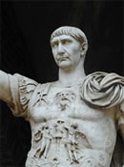
Trajan
Successful career in the military prior to becoming emperor
Made life better for ordinary citizens
Encouraged blood sport events

Slide 5
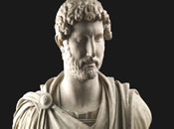
Hadrian
Trajan’s cousin
Complex
Liked the arts, avoided war where possible
Hated criticism and could become vengeful
Considered one of the most capable emperors by historians
Reformed the legal system
Kept the peace fairly well

