Slide 1
Theories of Human Migration to North America

Slide 2
Theory: Beringia
-During the ice age, a land bridge was created across the Bering Strait between Asia and North America.
-It existed from 28,000-10,000 years ago.
-Hunters likely followed herds across this land bridge.

Slide 3
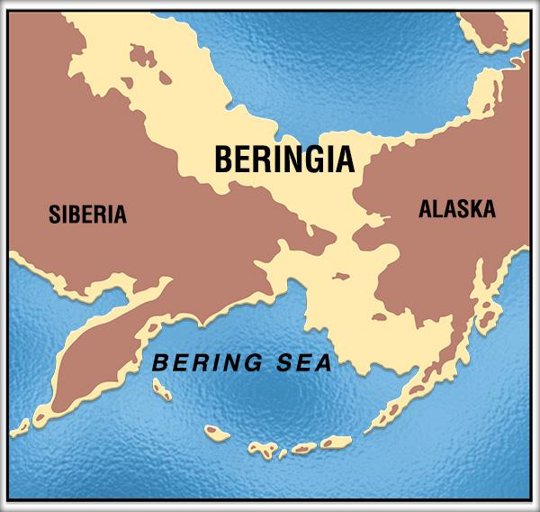
Land Bridge - Beringia

Slide 4
Beringia - Scientific Evidence
Sediment cores from Alaska and the Bering Sea support genetic evidence that the first human settlers of the New World could have spent thousands of years inhabiting Beringia.
-The samples have yielded plant and insect fossils, as well as pollen. This means that Beringia was inhabitable.
“These woody refuges could have provided fuel for fires, raw material for shelters, and cover for animals such as hares, birds, elk, and moose—game that humans could have hunted for food,” said Dennis O'Rourke, an anthropological geneticist at the University of Utah in Salt Lake City.
http://news.nationalgeographic.com/news/2014/04/140227-native-americans-beringia-bering-strait-pit-stop/

Slide 5
Theory - Beringia
-Over time, these Paleoindians moved down from Beringia and over the land of North America.

Slide 6
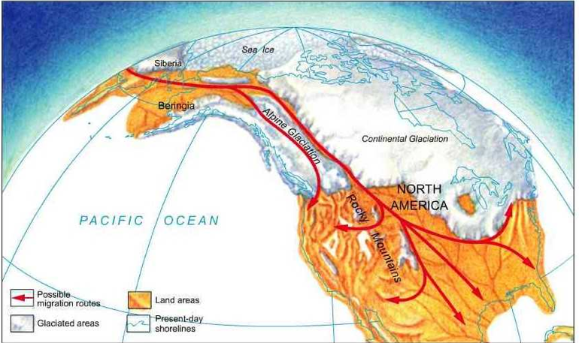
Migration through North America

Slide 7
Theory - Clovis
-In New Mexico, artifacts and scientific evidence have been found to prove that people were in North America around the time of the land bridge (9000 BCE).
-A town in New Mexico called Clovis had some especially important finds: spear points with mammoth bones. These spear points were named Clovis points, and the people who lived at the time named the Clovis people.
**What is important about this?

Slide 8
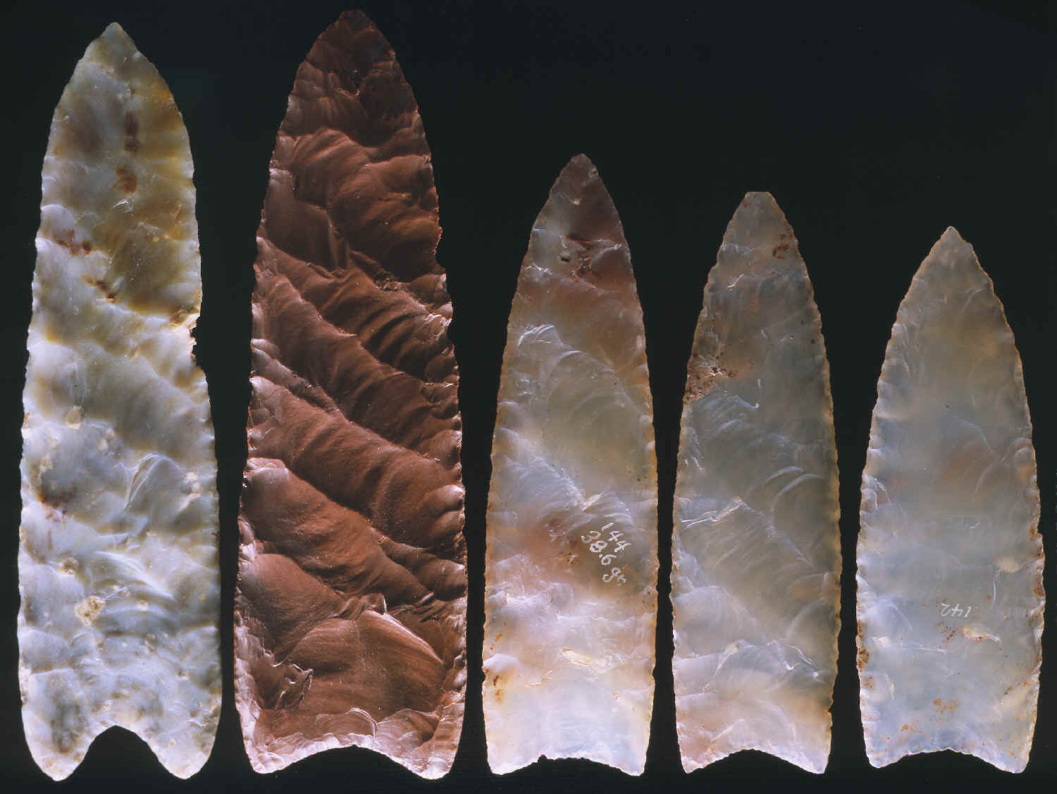

Slide 9
Clovis - Scientific Evidence
Comparison with other artifacts and carbon-dating have proven that they are the oldest proof of human life in North America.
They have been found all over North America.
**What do you think about this theory?

Slide 10
Theory - Monte Verde
In 1997, archaeologists discovered the remains of an ancient camp with artifacts even older than the remains of the Clovis culture (12,500 years old).
-They found artifacts made of stone, wood, and bone, parts of huts that had been covered with animal hides, and the preserved footprint of a child.

Slide 11
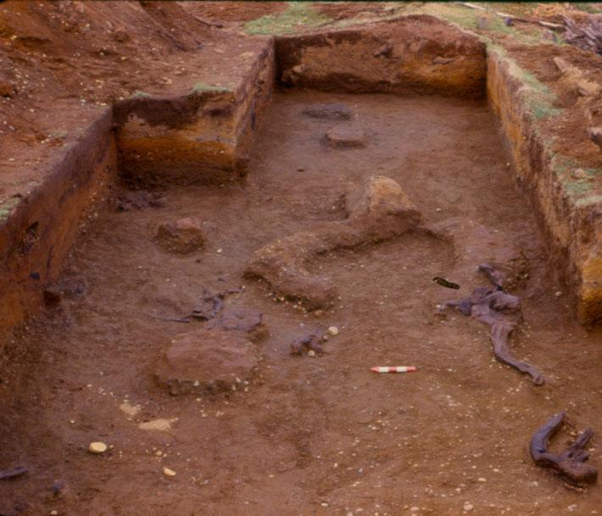

Slide 12
Theory - Monte Verde
These findings raised many questions:
-How early must humans have crossed Beringia in order to migrate all the way to southern South America by 12,500 BCE?
-Could they have come a different way?
-If so, how?

Slide 13
Monte Verde - Scientific Evidence
-Archaeologists did extensive testing to be sure the artifacts really were that old. And they were right.
-Evidence in other parts of the continents suggests that humans lived all over earlier than the Clovis people.
**What do you think?

Slide 14
Theory - Kennewick Man
-July 1996: two boaters stumble across a skull on the banks of the Columbia River in Kennewick, Washington.
-It was the skull of a man who lived 9,200 years ago and died at the age of 45 by a projectile wound to the head.

Slide 15
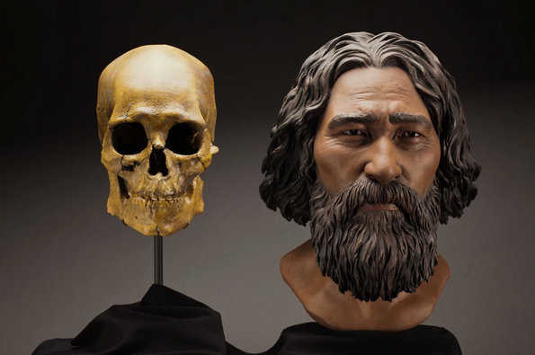

Slide 16
Kennewick Man - Scientific Evidence
-What was most interesting was that he didn’t have the features of modern Indians or those of the other paleoindians whose remains have been found.
-How was this determined? Every culture as distinctive physical features that tie them together.
-His features were European, unlike those of the other remains that had been discovered.
-DNA testing was completed, proving that he resembled south Asians, who have European features.

Slide 17
Kennewick Man
*What does this mean? It means that there was possibly more than one migration to North America, and by different means.
**What do you think?

Slide 18
Theory - Massive Die-Out
-About 11,000 years ago, the megafauna (large animals) of North America died out.
-This could have been caused by over-hunting (unlikely) or the arrival of diseases brought by human migrants.

Slide 19
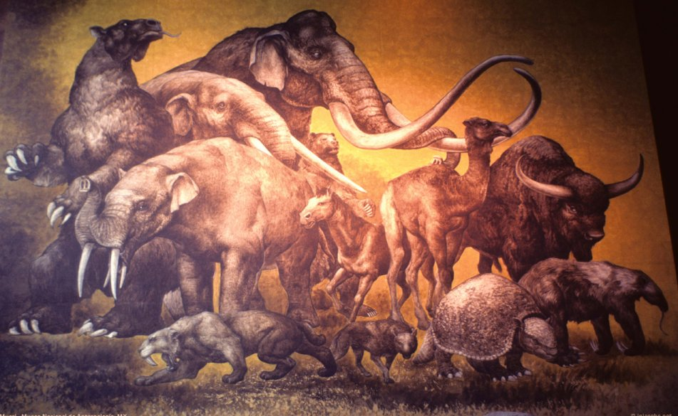

Slide 20
Massive Die-Out - Scientific Evidence
-We can tell there was a mass die-out because:
-They are extinct animals now
-There were more fossils left during this
period of time than before.
*This theory isn’t perfect. The die-out could have been caused by sudden climate change.

Slide 21
Massive Die-Out
*If humans did cause the die-out, it means there were a lot of them already living in North America 11,000 years ago.
**What do you think?

Slide 22
Theory - Genetic Testing
-DNA testing has shown that modern American Indians are descended from people who lived in East Asia, specifically in Siberia, thousands of years ago.
-Just how long ago is debated--some evidence suggests that they left Siberia 30,000 years ago--but it seems clear that most, if not all, of the first Americans came from Asia.

Slide 23
Genetic Testing - Scientific Evidence
-DNA testing to show that most migrants were from Asia.

Slide 24
Theory - Coastal Migration
It is possible that the first Americans migrated down the west coast of the Americas (which would have been free of ice during this ice age).
-They may have done so as early as 14,000 years ago.
-Perhaps they even used boats to skirt the coastline.

Slide 25
Coastal Migration - Scientific Evidence
-Human remains have been found in a part of California that was an island in the Pleistocene Era, suggesting that someone must have traveled there by sea.
-Remains have been found in areas that could not have been reached otherwise.

Slide 26
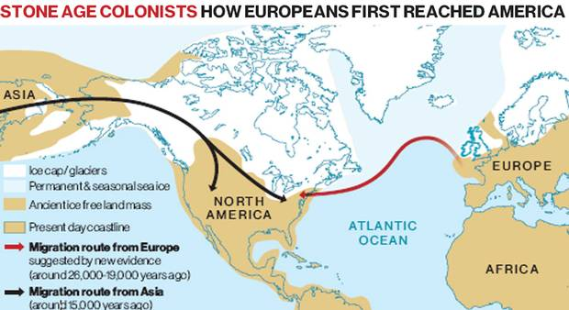
Coastal Migration
**What do you think?

Slide 27
Theory - Comparing Humans
-Some researchers have compared skulls of ancient humans in the Americas and in Europe.
-They argue that some early Americans arrived from southern Europe, moving up the coast of Europe, across Greenland, and into North America, perhaps by boat.
-Brazilian archaeologists have found remains in South America with features typically found among Africans or aboriginal Australians.

Slide 28
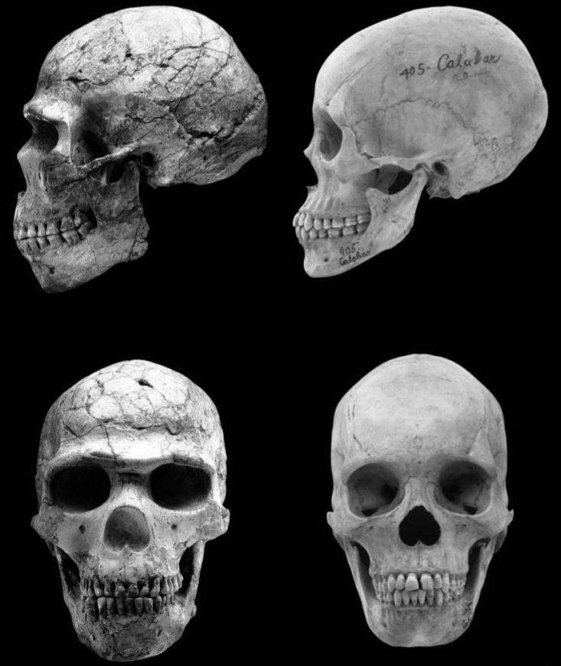

Slide 29
Comparing Humans - Scientific Evidence
-Comparisons of skulls and features of early humans.
-This is complicated. Features were more diverse then than they are now, so we can’t easily compare modern features to ancient features.

