Slide 1
Industrial Revolution
An Overview

Slide 2
What was it?
A change in how goods were made, a time of new inventions and social change

Slide 3
Congress passes a law
1790: Congress passed a patent law to protect the rights of those who developed “useful and important inventions”
Patent: gives the inventor the sole and legal right to the invention and its profits for a certain period of time

Slide 4
The Cotton Gin
1793: Eli Whitney invents the cotton gin.
Cotton gin: removed seeds from cotton fiber
Enabled one worker to clean cotton as fast as 50 people
Slavery was dying out until this invention

Slide 5
Textiles in Britain
More cotton = more textile products
Inventor’s like Richard Arkwright made textile production easier.
Britain was head of manufacturing textiles. There was a law to keep the machinery secret.
Samuel Slater: worked in a factory with machines invented by Richard Arkwright.
Memorized how textile machines worked and went to U.S.
Built cotton mill, using machines to make cotton thread.

Slide 6
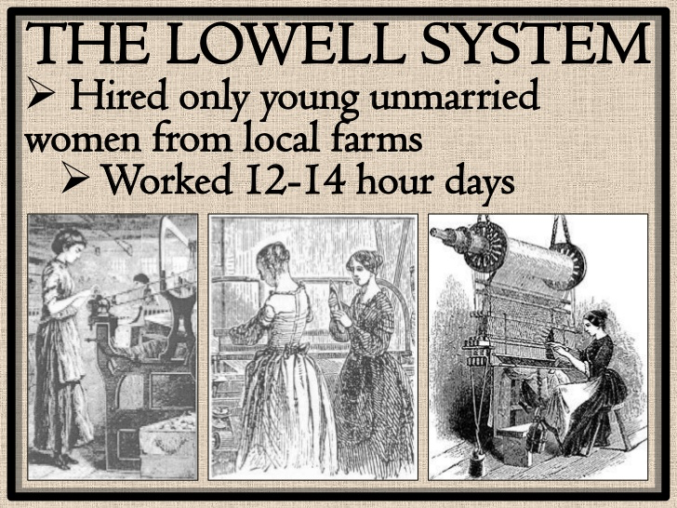
Lowell System
Francis Cabot Lowell: all stages of making cotton cloth in one building.
Hired women
Launched the factory system

Slide 7
More Inventions
Interchangeable Parts
Idea from Eli Whitney
Made objects with standardized parts where one piece could more easily be replaced if it broke rather than the entire machine.
Spinning Jenny and Water Frame: spin more than one thread at a time
Water frame could hold as many as 100 spindles!
Made it much faster to create textiles

Slide 8
Change in the U.S.
New England was the place for the Industrial Revolution
Poor soil so people willing to learn something else
Many rivers and streams to provide waterpower
Close to resources
Many ports for shipping
The South saw an increase in cotton production that led to an expansion of agriculture.
1790: 3,000 bales/year
1820: 300,000 bales/year
Cities: the growth of factories and trade led to urbanization (movement of people from farms to cities)

