Slide 1
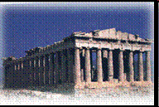
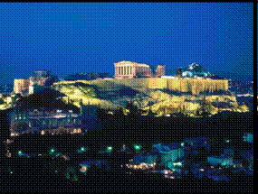
Ancient Greece: Introduction Notes

Slide 2
3 Major Periods of Ancient Greece Civilizations
1. Early Civilizations: ____________(Crete) and ______________ (mi se ne)
2. _____________Greece (flourishing of arts, literature, philosophy; domination by Sparta and Athens)
3. ______________Age: Macedonia Empire and Alexander the Great

Slide 3
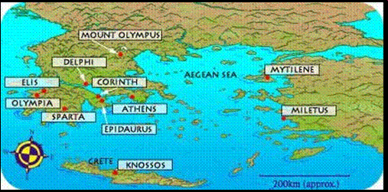
What are the characteristics of Ancient Greece’s geography?

Slide 4
Geographic Features
1.Sea: heavy ____________ on physical environment of Greece (Aegean Sea, Ionian Sea)
2.______________(with narrow valleys): cover more than ___ of Greece’s surface area and islands: more than 2000 islands (___________being the largest)
3.No major __________ on Greek mainland but fertile soil
4.Climate: winter= mild climate; summer= hot climate with __________from October to March = long growing season

Slide 5
Resources and Crops
RESOURCES
• grain
• fine cheese made of goat’s milk
• ___________
• wild game
• wool of sheep = _________
MOST IMPORTANT CROPS
• __________ = oil
• grapes = wine
• __________
• clay = pottery

Slide 6
Effects of Geography
Seafaring tradition: reliance on navy and fleets for __________ and ______________
Sea provided link to trade and cultural exchange with Mediterranean ___________________
________________: protection but lack of effective communication
Greece was organized into ___________ (independent city states) separated by seas and rugged mountains
Emergence of dominant city states (_________, Sparta)

Slide 7
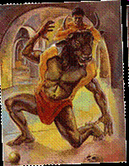
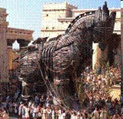
Greek Myths
FUNCTIONS
Explained the ___________
Means of Exploration
Provided _____________ and legitimacy
_____________________

Slide 8
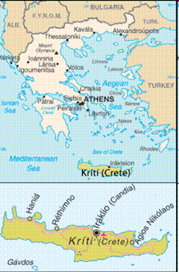
Early Greeks: The Minoans c. 3200 -1100 BCE
Lived on island of ___________
Great navigators and farmers
Palace led ____________, social and economic organization at ________________
Artistic expressions and grand ________________
Advancements in __________________
Built sanctuaries

Slide 9
Palace of Minos at Knossos (K-NOSS-oss)
Knossos-most powerful _______________ for Minoans
__________controlled all agricultural goods and products by storing in large _______________
Palaces became the ___________ of exchange for Minoan economy
Palaces had dozens of interconnecting _____________ rooms on two or more storys which were grouped around a large open _______________ (administrative and religious)

Slide 10
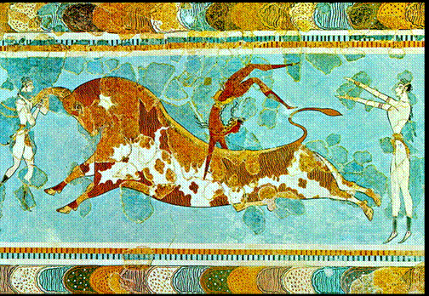
Minoan Culture
• Art work (drawings, murals or frescoes) at Knossos shows ________________ sports such as leaping over the backs of _____________bulls as well as dancing, athletics, and _________________

Slide 11
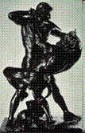
Myth of the Minotaur
Minoan Myth of King ___________ at Knossos
_____________ defeats the Minotaur (half man half bull) and escapes from the maze like structure called the ________________, saving the youth of Athens

Slide 12
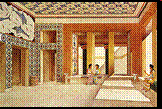
THEORIES FOR DECLINE OF MINOANS
1750 BCE- ______________destroys Minoan palaces
1628 BCE- volcano erupts at _______
1400 BCE- ________ between Minoans and Myceaneans led to decline of power

Slide 13
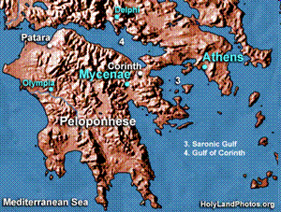
Enter the Mycenaeans c. 1700 – 600 BCE
1490 BCE- Minoan palaces had been rebuilt however all were destroyed except at __________ by Mycenaean warriors
Mycenaeans took control of _________vat Knossos by 1500 BCE
Myceneans controlled mainland _________ = main political center was Mycenae
More interested in war as ___________ and grave sites reflect ______________, weapons, armor and war as well as fortified palace walls
Slowly Minoan culture and traditions ________________

Slide 14
THEORIES FOR DECLINE OF MYCEANEANS
Shift in _______________ leading to drought forcing Myceanans to migrate to more fertile lands
Tribe of _______________ warriors from north of Greece (Dorians) destroyed Mycenaeans

Slide 15
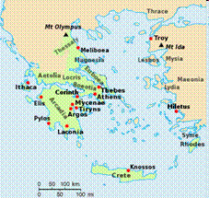
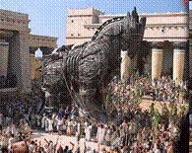
Trojan War
• Was the Trojan War a real historical event or merely a legend in Mycenaean history?

Slide 16
Trojan War
Two epic poems by Homer “________” and “Odyssey” describe the Trojan War
Approximately 1194-1184 BCE
Greeks vs __________
__________ of Sparta + ______ of Troy “the face that launched a thousand ships”
Achilles, Odysseus, Hector, Agamemnon and the Trojan ____________ •Archaeologist- Heinrich Schliemann (claims that he found _______ and the early Greek civilization of Myceaneans)

Slide 17
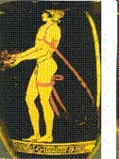
Archaic Period 750 – 500 BCE
Significant events
1) national ______________ (Homer)
2) resurgence of ________
3) colonization of Sicily and Italy
4) Olympic Games -_______ BCE
5) Stone ___________ of human figures
6) rise of city states (polis)

Slide 18
Classical Greece (500 – 336 BCE)
Polis (city states) = all had its own form of government, laws and ____________ (Corinth, Thebes, Athens, Sparta)
Dominance of ______________ as political power (Delian League)
Construction of Parthenon and ________________
Full development of democracy under _____________ of Athens
Classical age of Greece produced great literature, poetry, _______________, drama, philosophical thinkers and _________

Slide 19
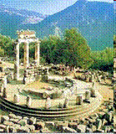
Oracle of Delphi
Dating back to 1400 BC, the Oracle of Delphi was the most important _________ in all Greece as the sanctuary of Apollo
Built around a sacred _________, Delphi was considered to be the center (literally navel) of the world
Questions about the ____________ were answered by the Pythia, the priestess of Apollo
Answers, usually cryptic or ambiguous
Arguments over the correct interpretation of an oracle were common, but the oracle was always happy to give another prophecy if more ________ was provided
It is believed that Pythia was high on hallucinative gases

Slide 20
Amphitheatre

Slide 21
Athenian Democracy “____________” = people; “___________” = rule
Monarchy and Kings
Rise in power of aristocracy & ___________________
Hoplites c. 675-650 BCE
Age of ______________
Democratic Reforms by Solon and Cleisthenes = Three _____________ of Athenians Democracy: 1. Council of 500 2. Assembly 3. _____________
Athens lived under a radically ________________ government from 508 until 322 BCE. The People governed themselves, debating and voting _______________ on issues great and small, from matters of war and peace to the proper qualifications for ferry-boat captains

Slide 22
How effective was Athenian Democracy?
Ancient Athens is often referred to as the __________ of democracy
Democracy flourished during the ___________ Age of Athens (4th Century BCE) under Pericles
___________ Democracy= All the male citizens would gather, discussed the issues, and then voted on them.
However, Athenian democracy was _____________. Only male citizens were allowed to take part in running the government (made up approx. 10% of population). Women, slaves, and foreigners were excluded from public affairs. The policy of _____________ also created some ____________ as the Assembly could exile a speaker / leader by vote if they feel they are too powerful

Slide 23
Daily Life in Athens
MEN
Only men could be _______________; men ran ____________________
Advancements in culture, ____________, literature, philosophy, wealth, expansion, _________
Reliance on ___________ and ____________ opened up free time for men to discuss philosophy and participate in ____________

Slide 24
Daily Life in Athens
WOMEN
Women could not _________, hold office or own property and did mostly ________________duties
Education involved spinning, weaving and ______________ arts
At 15 years old, girls were considered ready for _____________
SLAVES
Ratio of slaves to free men was quite high as historians estimate that as much as _____% of people in Athens area were slaves
Slaves were household servants; had few __________; some could gain freedom from generous ______________

Slide 25
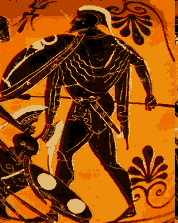
Spartan Government:
Democratic Timocratic Monarchial Oligarchy
Government ruled by a Council= made up of 2 kings (_____________) and 28 nobles (over age of ____) who made most political _____________and foreign policy and was supreme ______________ court
Assembly of the _____________ (democracy)- Spartan males over the age of 30 who could veto and approve ____________made by Kings and Council
5 __________ (oligarchy)- led the council, ran the military and educational system and could veto any ruling made by the Council or Assembly

Slide 26
Spartan Government
Spartan government was considered one of the most ___________ in all of Ancient Greece = led to a warrior and _____________ state (state above individual)
Aries- God of ________ was a patron god of the city, of wars, battles, and warriors, and also of _____________________ in battle.

Slide 27
Daily Life in Sparta
MEN
At 30 men became _____________ and could _______ in Assembly, marry, own a house
Educated in ____________, fitness and use of weapons
Boys started military training at the age of __; joined military at age of ___; end of military service at the age of ___
Soldiers given land which was farmed by the _____________

Slide 28
Daily Life in Sparta
\WOMEN
Girls taught reading and ____________
Participated in running and wrestling, foot races, staged ____________
Wives of Spartan soldiers supervised __________
Expected and driven to produce strong and healthy _________________ and be loyal to the state
Spartan women could own and control property but held no ____________rights
SLAVES
•Slaves were called _____________ (agricultural slaves / peasants) made up 2/3 of population = defeated Messenian peoples
Attempted revolt in 640 BCE but was _____________ (this forced Sparta to create a stronger army)

Slide 29
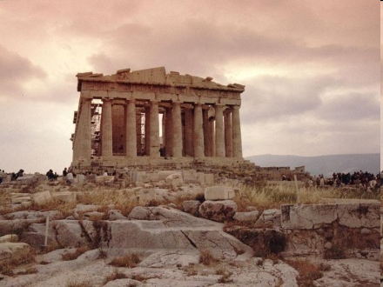
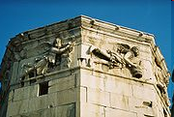
Greek Architecture
Parthenon
Acropolis
Statue of Athena
Public buildings
Columns
Marble
Frieze

Slide 30
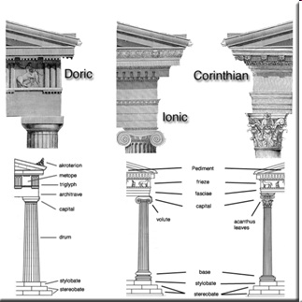
Greek Columns
Greeks developed three different orders
__________ & __________ = 6th century BCE
_______________= 5th century BCE and was further developed and used by Romans

Slide 31
Greek Art
First to use ______ on a flat surface by using different __________ to give illusion of depth
Focus on the concept of the “_________” (beautiful, life like youthful, calm expression)
Depictions of ________
__________ of nude forms (detailed and proportional)
Emphasis on elaborating on _____________ styles
Money devoted to building theatres, stadiums, gymnasiums, ___________

Slide 32
Greek Philosophers and Thinkers
Philosophers: Socrates, Plato, ___________
Establishment of philosophical __________that examine issues such as true knowledge, the ______, love, beauty and _____________ learning
Logical thinking, _____________, politics
Playwrights: ______________, Euripides, Aeschylus
Other: Hippocrates, Epicurus, Archimedes, ________________

Slide 33
Hellenistic Era: Greece
Period between conquest of Persian Empire by __________________the Great to establishment of _______________ supremacy
The word, Hellenistic, is derived from the word, ____________, which was the Greek word for the ____________. The Hellenistic age "hellenized" the world
Spread of Greek ____________ and language throughout Near East, Mediterranean and Asia Minor
Exported Greek culture: architecture, ___________, law, literature, philosophy, religion, and art as models of perfection

Slide 34
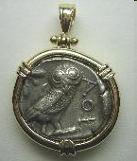
Trade and Coinage
Most important crops: _________ and grapes
Items traded: olive oil, wine, silver, white marble, pottery, furniture, ___________, textiles for grain, glass, ivory, timber
Trade by ___________ system
Coinage emerged from metallurgy that was ____________
8th and 7th century BCE, silver pieces were ____________ by government
First _________ 7th BCE in Lydia
By 5th century BCE, most common coinage in Mediterranean was __________ coin with owl on one side and Athena on other

Slide 35
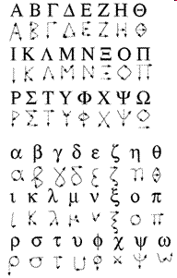
Legacies of Greece
City states (polis)
Thought & Philosophy
Greek Language
Politics
Democracy
Great Thinkers
Art and architecture
Myths and literature

