Slide 1
Lewis and Clark

Slide 2
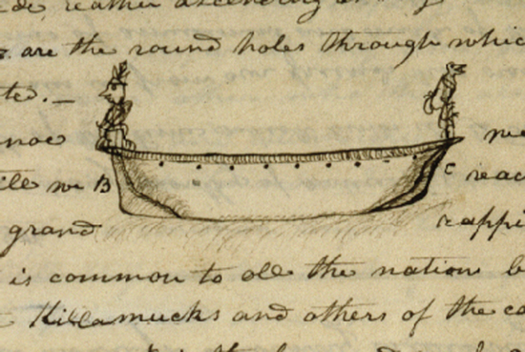
By Meriwether Lewis

Slide 3
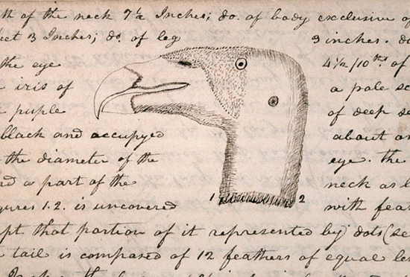
Head of a vulture By Meriwether Lewis

Slide 4
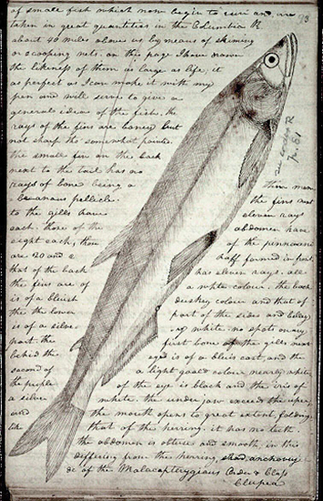
Eulachon by Meriwether Lewis

Slide 5
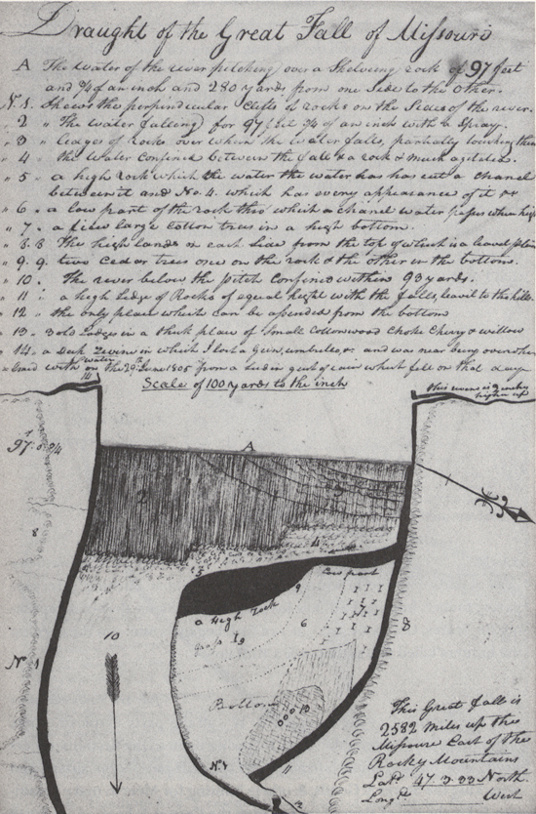

Slide 6
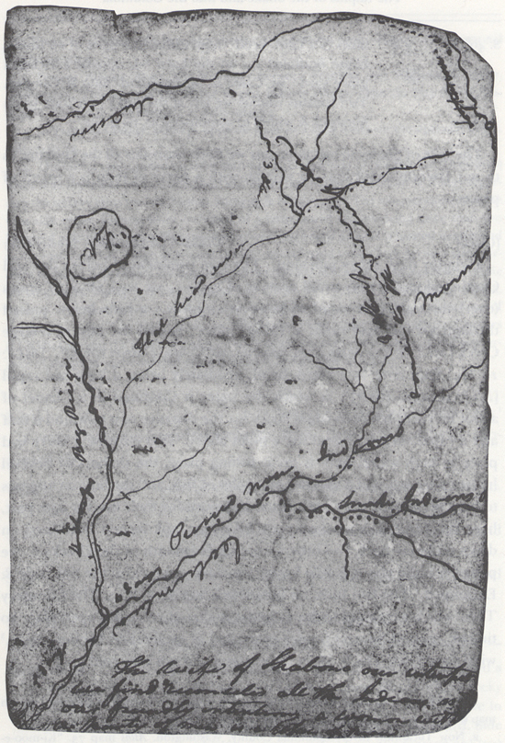
Columbia River and Affluents, Washington, ca. October 13, 1805, Elkskin-bound Journal

Slide 7
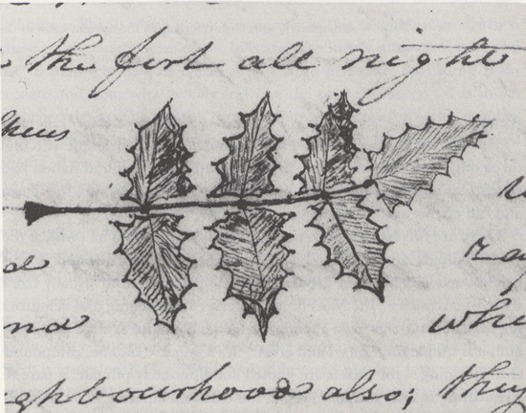
Evergreen Shrub Leaf (Oregon grape, Berberis aquifolium), February 12, 1806, Voorhis No. 2

Slide 8
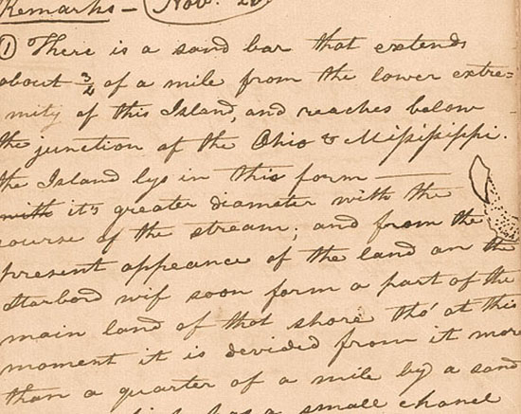
Sand Bar, November 20, 1803, Eastern Journal
By Meriwether Lewis

Slide 9
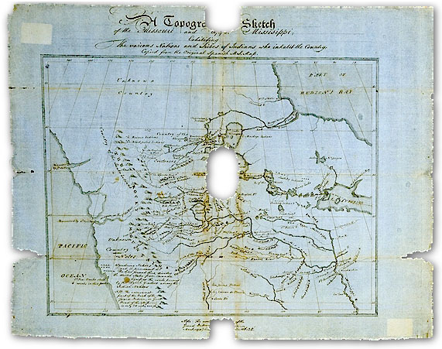
Map of the whole journey by William Clark

Slide 10
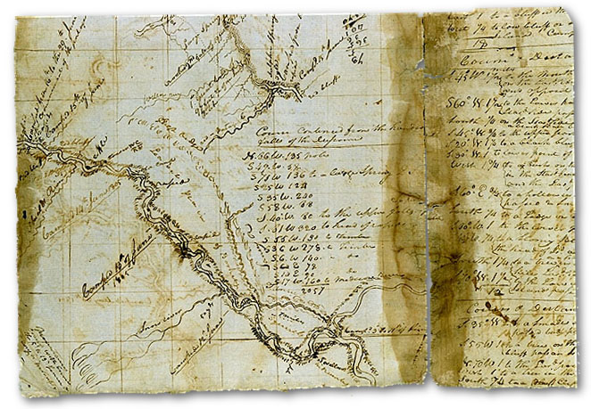
"Soulard Map of the Missouri and Upper Mississippi, 1802" by William Clark

Slide 11
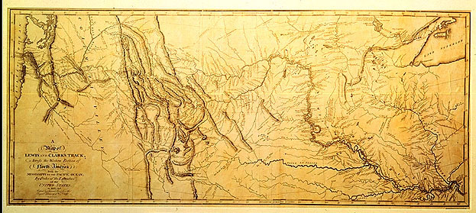
"Map of Lewis and Clark Track" Original by Clark, 1810. Copied by Samuel Lewis 1814

Slide 12
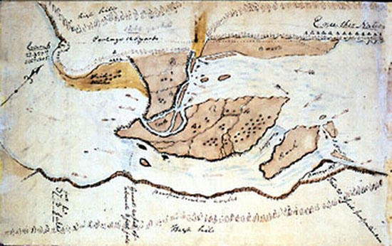
Great (Celilo) Falls of the Columbia River, Washington and Oregon, October 22–23, 1805, Codex H, p.1 by William Clark

