Slide 1
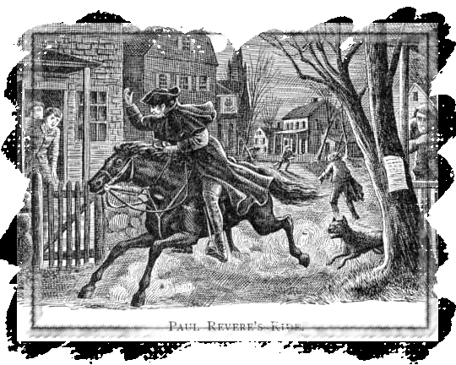
“The Shot Heard Round the World”
American colonists stockpiled weapons in Concord, Massachusetts
800 British troops marched through Lexington on the way to Concord
Paul Revere: “The British are coming!”
Notes:
Enough was enough, American colonists stockpiled weapons in Concord, Massachusetts, outside Boston. Then fighting began. The first battles occurred outside Boston, in Lexington and Concord. It is often called “The Shot Heard Around the World” as 13 colonies decided to challenge the mighty British Empire. Paul Revere, one of the Sons of Liberty, warned colonists, “The British are coming!”

Slide 2
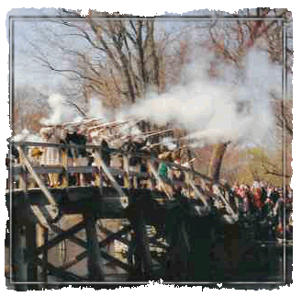
The Armed Militia
Known as “Minutemen”
70 Minutemen on the Village Green
Known as the Battle of Lexington and Concord
Uncertain which side fired first
50 Americans killed and 45 wounded or missing
65 British killed and 208 wounded or missing
Notes:
This was truly a mismatched battle from the start, but the outcome was monumental. Farmers and shopkeepers responded to Paul Revere’s call to arms by being ready to fight at “a minute’s notice,” earning them the nickname “Minutemen.” Seventy Minutemen were waiting for the British soldiers at the Village Green, on April 19, 1775. Historians are still uncertain about which side fired the first shot. Approximately 50 American colonists were killed and 45 were wounded or missing; the British, on the other hand, lost approximately 65 soldiers and 208 were wounded or missing. The battle was a humiliating defeat for the British, who had more organized, highly trained militias. However, they didn’t use guerilla warfare as the Minutemen chose to do and thus the British were unprepared for ambushes and easily slaughtered.

Slide 3
Lexington and Concord

Slide 4
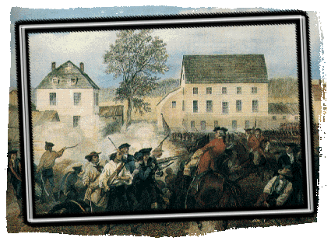
Lexington Diary
“At 10 of the clock last night, the King’s troops marched out from the bottom of the common, crossed over to Phips Farm, marched on ’till they came to Lexington.”
—Timothy Newell (1775)
Notes:
This is an excerpt from Timothy Newell’s diary. “At 10 of the clock last night, the King’s troops marched out from the bottom of the common, crossed over to Phips Farm, marched on ’till they came to Lexington.” –Timothy Newell (1775)

Slide 5
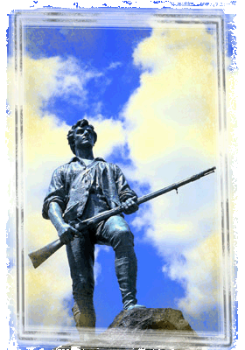
Lexington Famous Quote
“Stand your ground, don’t fire unless fired upon. But if they mean to have a war, let it begin here!”
—Captain Parker
Single click the speaker icon to hear the clip >>>>
Notes:
Many British soldiers felt bad about shooting their countrymen. Listen to Captain Parker’s words.

Slide 6
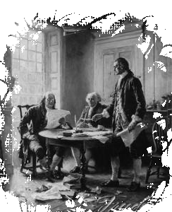
Second Continental Congress
Decided to officially separate from Britain
Committee selected to draft the reasons for separation
Thomas Jefferson selected to write document
Met in Philadelphia
Notes:
It was time to make the split from Great Britain official. After the initial battles of the war, the Second Continental Congress convened in May 1775 in Philadelphia to call for an official separation from Britain. A committee including Thomas Jefferson was selected to write a draft of all the reasons the colonists wanted complete separation from Britain. Jefferson was chosen by congressional vote to draft the document.

Slide 7
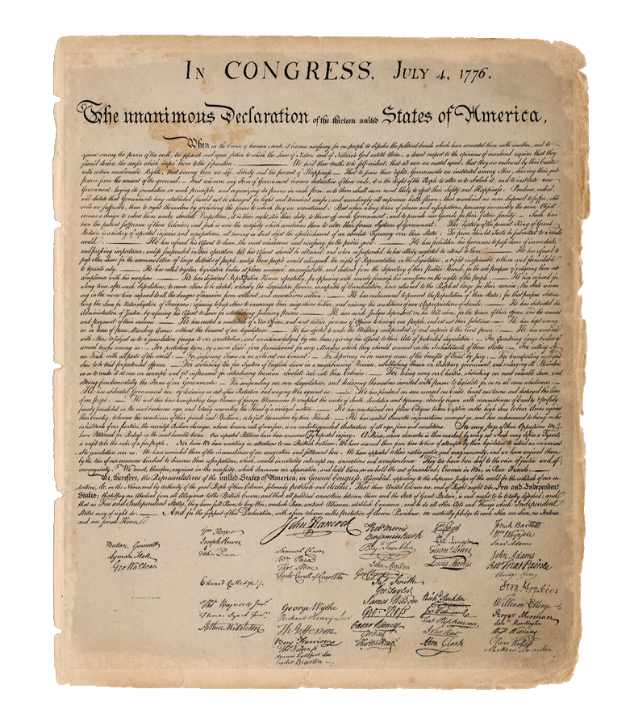
The Declaration of Independence
Written by Thomas Jefferson
It is the “Birth Certificate of the United States”
Document listed rights and grievances against King George III
4 parts
Preamble
Declaration of rights
List of Grievances
Resolution
Notes:
A new country was about to be born. Thomas Jefferson was the unanimous choice to draft the document that would become the “Birth Certificate of the United States,” the Declaration of Independence. Benjamin Franklin and John Adams aided Jefferson with Declaration revisions. The document clearly listed colonists’ rights and their grievances against King George III.

Slide 8
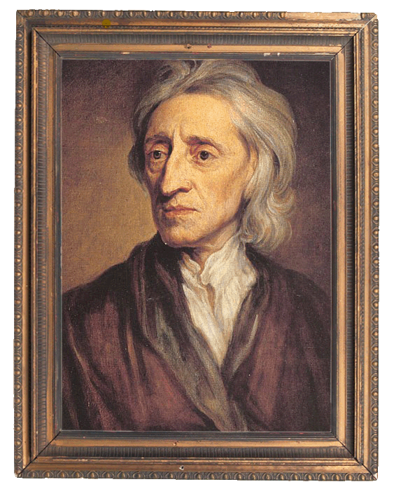
Key Quotes in the Declaration
“We hold these truths to be self evident: that all men are created equal”
“That they are endowed by their creator with certain unalienable rights”
“That among these are life, liberty, and the pursuit of happiness”
Locke
Notes:
Many of the phrases that Jefferson included in the Declaration of Independence came from the works of the British political philosopher John Locke. Several of the Declaration’s quotes are well-known by most Americans even today. Some edited to match today’s punctuation rules include: We hold these truths to be self-evident: that all men are created equal, that they are endowed by their creator with certain unalienable rights and that among these are life, liberty, and the pursuit of happiness.

Slide 9
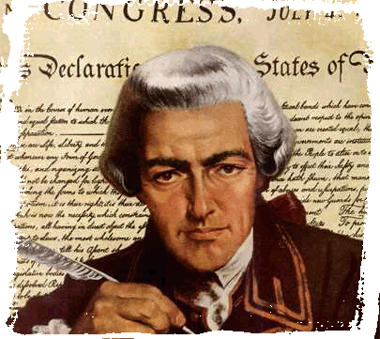
The Declaration of Independence
John Hancock first to sign in large print
Anyone who signed it and was caught would be hanged
“We must all now hang together, or most assuredly we will all hang separately." —Benjamin Franklin
Hancock
Notes:
John Hancock, as President of the Second Continental Congress, wanted the king to know he meant business. He signed the Declaration in very large letters to send a message to King George III, signing in large print so “King George could read it without his glasses.” Any colonist whose signature appeared on the document and who was apprehended by British soldiers or officials would be hanged in public as a warning to other colonists. This possible horrible death was worth the risk to the men who signed The Declaration of Independence. In the words attributed to Benjamin Franklin, “We must all now hang together, or most assuredly we will all hang separately.”

Slide 10
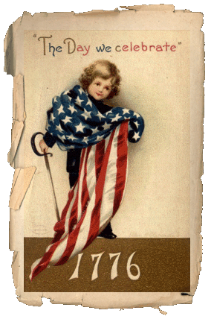
Independence Diary
“There were bonfires, ringing bells, with other great demonstrations of joy upon the unanimity and agreement of the Declaration.”
—Christopher Marshall (1776)
Notes:
The Declaration put into words what many revolutionaries were feeling. “There were bonfires, ringing bells, with other great demonstrations of joy upon the unanimity and agreement of the Declaration.” – Christopher Marshall (1776)

Slide 11
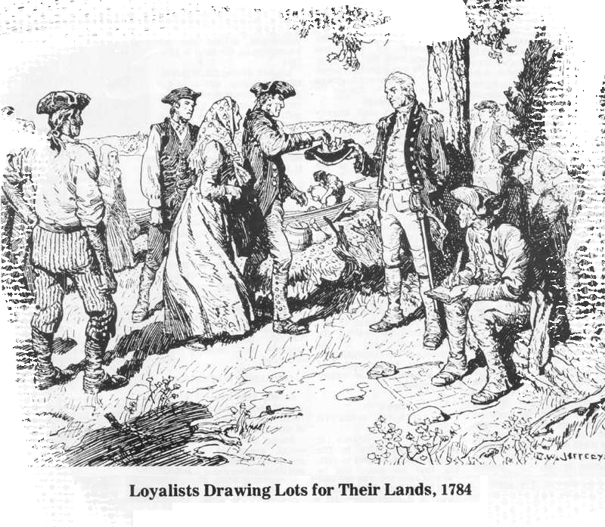
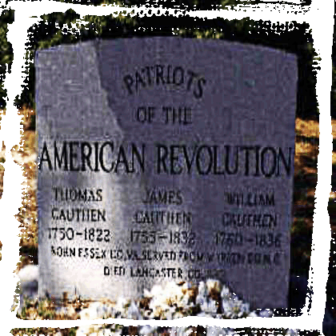
Choosing Sides
Patriots – Supported the Revolution
Loyalists – Americans who supported the King
Red Coats/ Lobsterbacks – British Army
Notes:
When teams were divided up to pick sides in the battle, American colonists were split. One-third were for the Revolution; they called themselves Patriots. One-third who named themselves Loyalists were against it. One-third apparently didn’t care to choose sides.
When it was all said and done, two major groups of the War emerged. The first lineup included the Patriots fighting against King George III. The second group were the Loyalists teamed up with the king’s Red Coats, called Lobsterbacks, fighting against the Patriots.

Slide 12
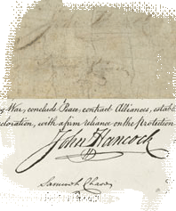
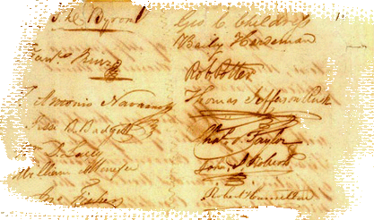
What Happened to those who Signed?
Five were captured by the British, though eventually released
Approximately 12 had their homes ransacked and burned
One lost his son in the Continental Army
Several suffered wounds in various battles
Notes:
Signing the Declaration of Independence wasn’t a task for the weak or fragile. Many of the men were opening themselves and their families up to great suffering and tribulation. It’s interesting to note what happened to some of them. Five were captured by the British Army, approximately twelve had their homes ransacked and burned, one lost his son in the Continental Army, and several suffered wounds in various battles during the Revolutionary War.

Slide 13
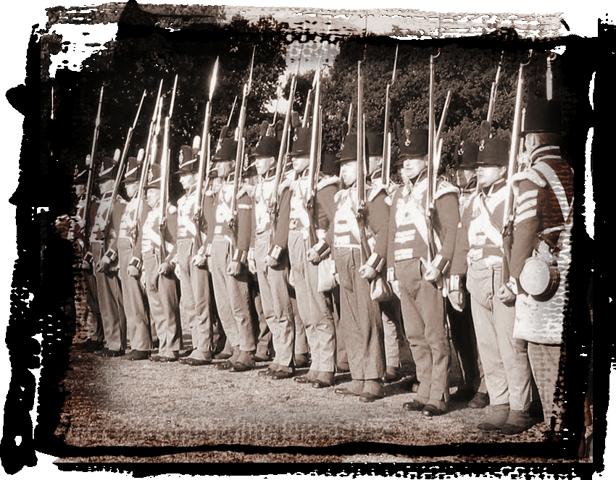
Revolutionary Armies – The British
British Army most powerful in world
Also well-equipped with weapons
Highly trained and disciplined for war on land or high seas
Notes:
The British had one of the most powerful armies in the world at this time. The men who served in the British Army of North America were well-equipped with state of the art weapons. They were also well-trained, well-disciplined, and strong. They endured daily drilling which included maneuvers with heavy weapons. One Brown Bess rifle and bayonet weighed about 11 pounds 4 ounces. Their Navy was also world-renowned for its strength in artillery, speed of their warships, and training of their men.

Slide 14
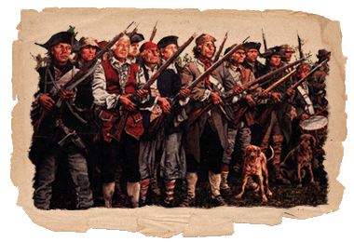
Revolutionary Armies
Americans shot more accurately
British carried three days provisions
British gear weighed about 100 pounds
Notes:
American soldiers may not have had all the high tech toys and creature comforts that the British did, but they had one advantage. The American soldiers were known for their superior rifle technology and sharp shooting skills, even back then. The British Brown Bess rifle was not as accurate as the American Pennsylvania and Kentucky rifles. The British also carried three days provisions, so their gear weighed about 100 pounds. Therefore, although the Americans were outnumbered by the British Army and Navy and had fewer weapons, they were quicker, had better guns, were excellent shots, and had great strength and endurance.

Slide 15
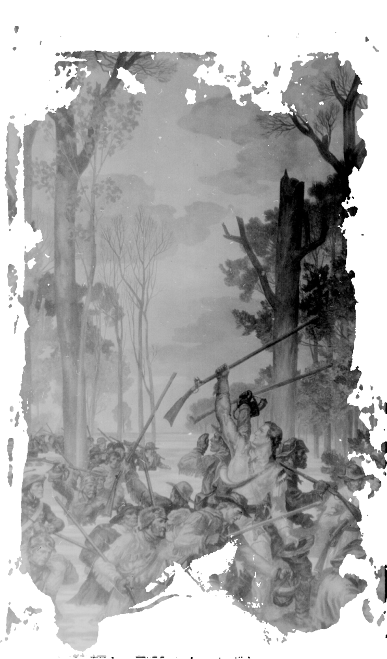
Revolutionary Armies – The Americans
Revolutionary Army knew lay of the land
Used weapons appropriate for landscape
Wore pieces of different uniforms
Brown army clothing
Notes:
The Americans were truly rebels in all sense of the word. The American Army knew the lay of the land, useful for guerilla warfare. Most carried tomahawks, not bayonets, which were unwieldy in the heavily wooded areas. The tomahawks and short-blade swords were much more useful during battles in tight quarters than the British troops’ bayonets, giving the Patriots the advantage. They didn’t have the time, money or woman-power to have proper uniforms hand-sewn, so they wore a combination of mix and match uniforms. George Washington, voted in as General Washington to lead the troops, preferred brown army clothing.

Slide 16
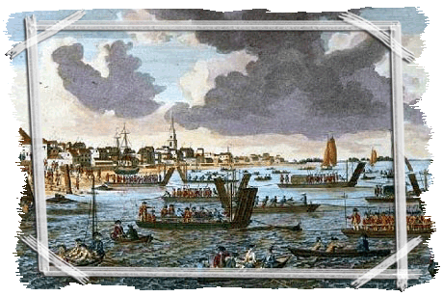
British Advantages
Well-equipped
Disciplined
Strongest navy
Notes:
It seems like the British had an unfair advantage over the Americans. They had ample experience in world affairs; as previously mentioned, they were well-equipped, highly disciplined, and had the world’s strongest navy. But the Americans proved to be a different opponent than traditional armies worldwide.

Slide 17
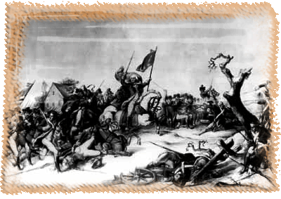
American Advantages
Accuracy of the rifle
Knowledge of the land
Guerilla warfare tactics
Superb command
Notes:
The American underdogs weren’t out of the competition. Americans were especially blessed with accuracy in shooting rifles. They had local knowledge of the land and Native American weapons and tactics. From the Native Americans, they had learned how to use the tomahawk and guerilla warfare strategies. Finally, the Americans had a superb military command with General Washington.

Slide 18
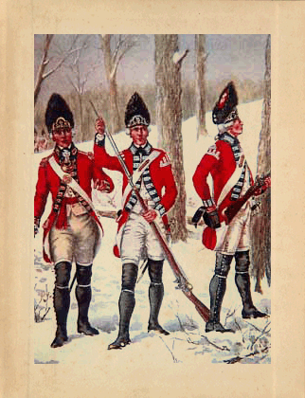
British Soldier Quotes
British soldiers faced new challenges
“[Darn] those Americans. They will not stand and fight.”
“Settle your affairs at home before leaving for The Colonies; you probably won’t be coming back again.”
Single click the speaker icon to hear the clip >>>>
Notes:
Different entries in British diaries are quite useful in understanding the difficulties the British faced by fighting Americans as seen in the statements made by British soldiers. One of the quotes are “Damn those Americans. They will not stand and fight.” Listen to the soldiers’ quote.

Slide 19
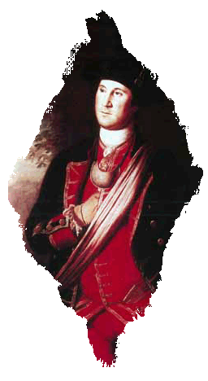
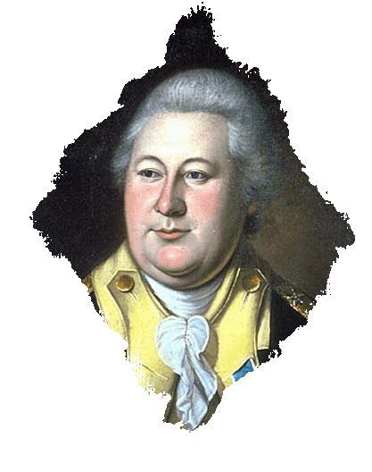
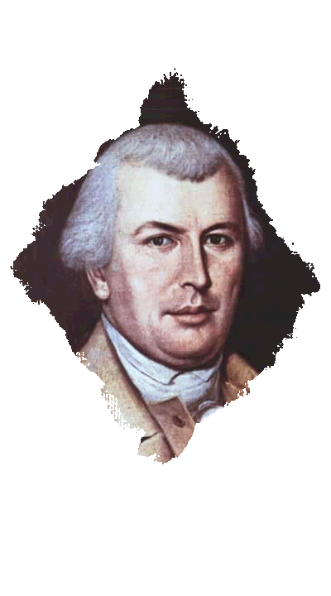
Military Leaders—American
George Washington: Commander of Americans Forces
Nathanael Greene: Top Strategist
Henry Knox: Artillery Expert
Benedict Arnold: Commander under Washington
Notes:
George Washington wasn’t a one-man band. He was assisted by other American military leaders, including top strategist Nathanael Greene and artillery expert Henry Knox, both of whom excelled at a variety of military tasks.

Slide 20
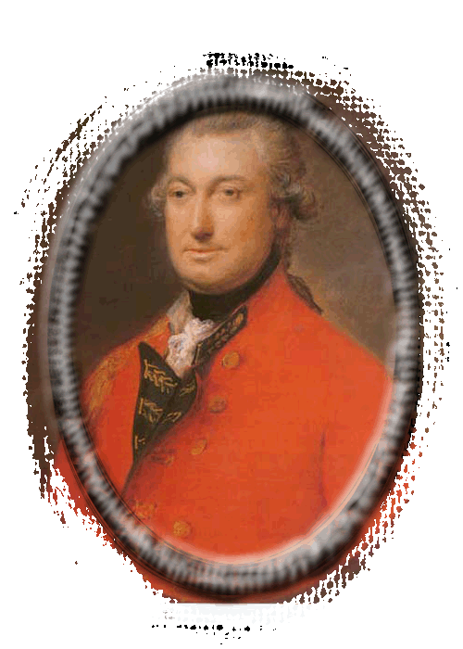
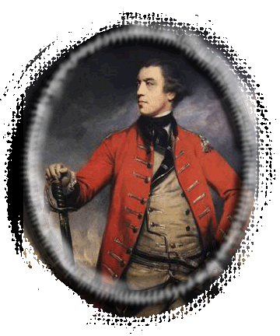
British Leaders
General Charles Cornwallis
General John Burgoyne
Benedict Arnold
William Howe
All considered America one of the worst places to serve
Notes:
The English didn’t exactly find America an ideal vacation spot to hold a war. Great Britain’s military leaders, such as General Charles Cornwallis and General John Burgoyne often considered America one of the least desirable places to serve. The dense forests and seasonally extreme heat offered major obstacles to traditional warfare.

Slide 21
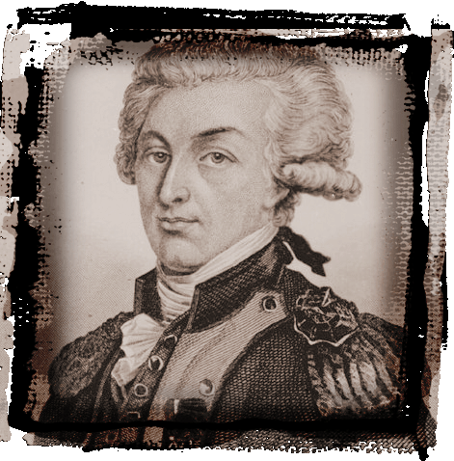
Other Key Players
France, Spain, Germany and Poland
Hessian mercenaries from
Germany
The Marquis de Lafayette: Frenchman who supported American cause
Huge percentage of American gunpowder came from France
Marquis de Lafayette
Notes:
Some historians refer to the American Revolution as a “World War,” because other countries participated in the American Revolution including France, Spain, Germany, and Poland. The leaders of each country either had already claimed part of America or wanted some of the land for themselves. The French, especially, were instrumental in helping the American Army win the War because they had settled parts of the country in the South over a century before the English settlers arrived in the East. The Marquis de Lafayette was a Frenchman who supported the American cause and was a major leading hero of the Revolution. Also, a huge percentage of American gunpowder came from France.

Slide 22
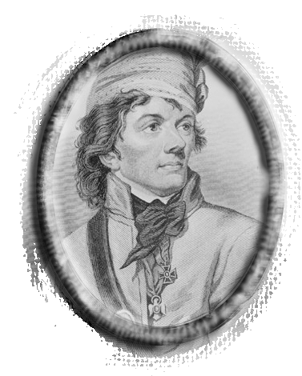
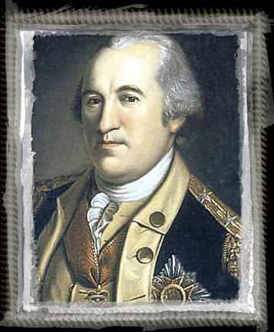
Other Key Players
Bernardo De Galvez: Spanish lord in Mexico
Baron Friedrich von Steuben: German military commander who helped train American troops
Nathan Hale: American Spy “ I regret that I have but one life to lose for my country.”
Notes:
In addition to Lafayette, Polish and German leaders helped the Americans. In particular, Polish military engineer Thaddeus Kosciusko and German military commander and trainer of American Army troops Baron Friedrich von Steuben aided the American Army’s cause.

Slide 23
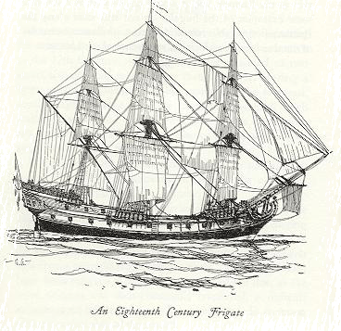
The War at Sea
Approximately 3,000 men enlisted—America made 13 Frigates
Most, if not all, were destroyed or captured
Colonial Navy authorized by Continental Congress October 13, 1775
Notes:
One doesn’t think about the Revolutionary War being fought at sea, but approximately 3,000 men enlisted in the Colonial Navy. America built thirteen Frigates; however, all were destroyed or captured by the British Navy. The Colonial Navy was authorized by the Continental Congress on October 13, 1775.

Slide 24
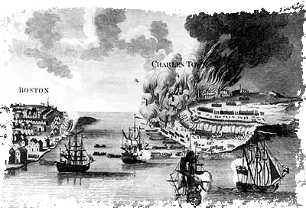
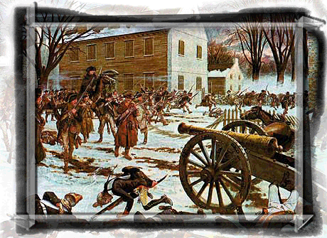
Major Battles
Fort Ticonderoga
Bunker Hill
Trenton
Notes:
The following battles, in chronological order, were instrumental for America’s victory: Fort Ticonderoga, Bunker Hill and Trenton. All are significant and special in their own way.

Slide 25
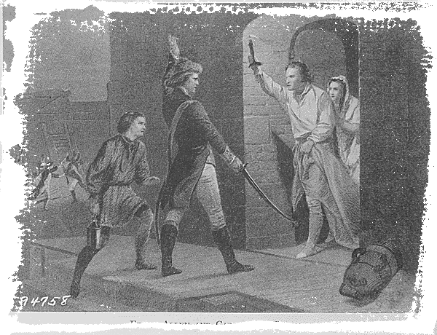
Fort Ticonderoga—1775
Key strategic location in New York
Ethan Allen and about 125 Green Mountain boys attacked fort
Notes:
The first of these major battles was at Fort Ticonderoga, in New York. It was located in a strategic area in that whoever controlled the fort also controlled vital troop movements. From Ticonderoga the American Army could deter British troops coming down from Canada. Military leader Ethan Allen and about 125 Green Mountain Boys, a branch of the American Army, attacked the fort in May 1775 and were victorious.

Slide 26
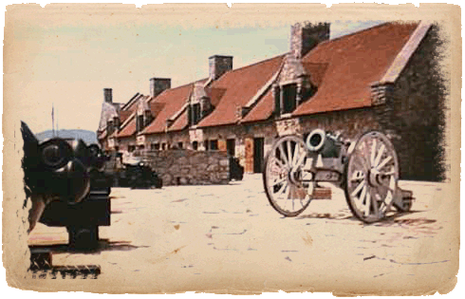
Ticonderoga
The Fort was taken without firing a shot
British officers and women and children were captured
Cannons were taken from Ticonderoga to Boston
Henry Knox: American Army top artillery commander
Major hero of American Revolution
Notes:
This was the battle where there wasn’t a single shot heard around the world. The Fort was taken without firing a shot. British officers and women and children were captured. Cannons were taken from Ticonderoga to Boston. The cannons from Ticonderoga would be dragged over rough terrain and would be used at future battles. Henry Knox was America’s top artillery commander and one of the major heroes of the Revolution.

Slide 27
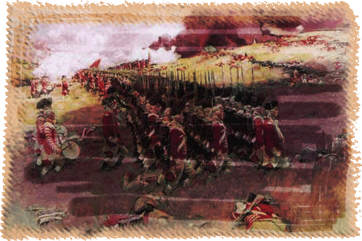
Battle of Bunker Hill - 1775
Bunker Hill located near Boston
Americans built fort on top of hill overnight
Red Coats victorious in third charge
Americans ran out of ammunition
Moral victory for American Army
Notes:
Another important battle was one that the Americans lost, yet they felt triumphant. The Battle of Bunker Hill, actually fought on Breed’s Hill just outside of Boston in June 1775, inspired the Americans to believe fully that they could stand up to the British Army. Although about 1,400 Army of New England soldiers occupied the defenses, and 2,500 Red Coats unsuccessfully charged the hill numerous times, the Red Coats defeated the American soldiers in the third charge only because the Americans ran out of ammunition. The Americans lost the Battle of Bunker Hill, but considered the battle a moral victory.

Slide 28
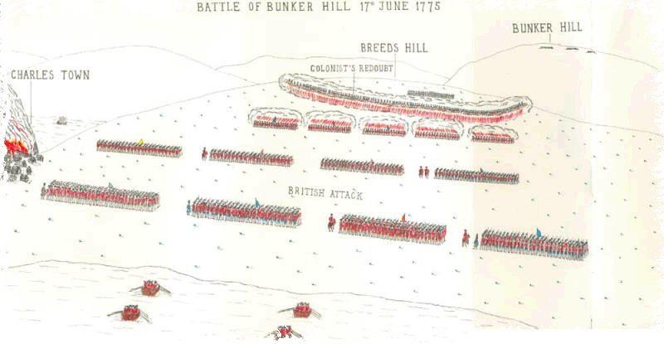
Bunker Hill
Costliest battle for British during whole war
British casualties 1,054
American casualties 441
British began to get nervous
Washington took command of the army two weeks after this battle
Notes:
The Battle of Bunker Hill was the costliest battle for the British in the eight-year war. British casualties numbered 1,054, while American casualties were 441. At this point, the British Empire realized they faced a full-scale war with the Americans. Two weeks after this battle, Washington took command of the American Army.

Slide 29
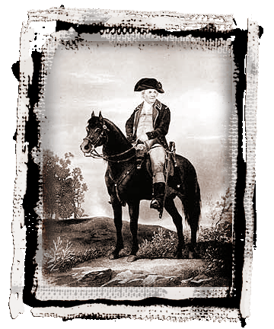
Bunker Hill Famous Quote
“Don’t fire until you see the whites of their eyes.”
—Israel Putnam
Notes:
The battle on Bunker Hill was furiously violent. The quote “Don’t fire until you see the whites of their eyes” is often attributed to Israel Putnam, but sources are not completely in agreement. Regardless of who actually spoke the words, they have gone on to symbolize any soldier who is calm in the face of a seemingly insurmountable enemy.

Slide 30
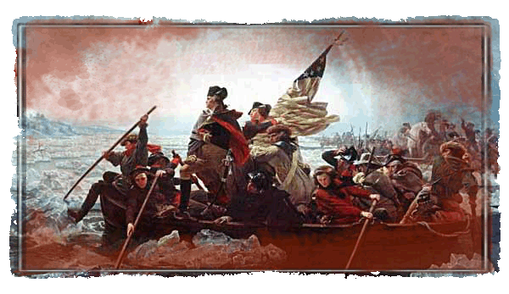
Battle of Trenton—1776
Surprise attack the day after Christmas
Washington crossed the Delaware
Approximately 1000 German soldiers fighting for the British captured
Notes:
The third significant battle called the Battle of Trenton was a surprise attack by General Washington. Washington and his men crossed the Delaware on Christmas night 1776. They caught trained German soldiers, known as Hessians, napping early the next morning. Washington’s brilliant strategy led to a great American victory.

Slide 31
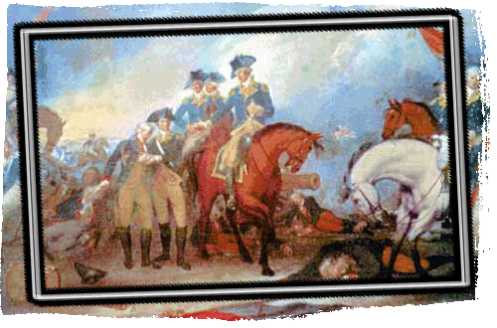
Trenton & Princeton
American casualties were four
German leader, Colonel Rall mortally wounded
Washington cleared British from central New Jersey
Notes:
The attack on Trenton gave the American Army their first great victory of the war with only four casualties. The Hessians had spent too much time celebrating the holidays and were caught off guard. Colonel Rall, the German leader, was mortally wounded during the surprise attack. Washington cleared the British from central New Jersey.

