Slide 1
Rome
Resource: Mechikoff /Estes, A History and Philosophy of Sport and Physical Education, Fourth Edition © 2006, The McGraw-Hill Companies, Inc.

Slide 2
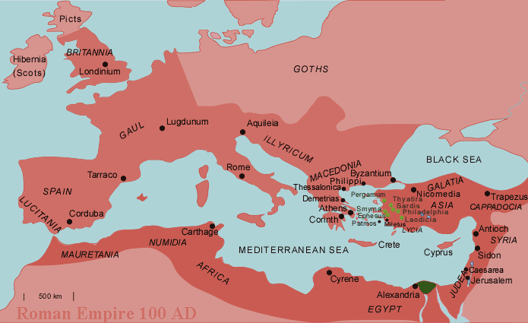

Slide 3
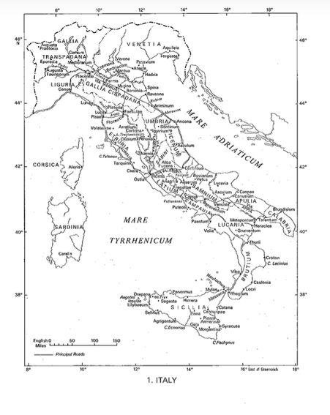

Slide 5
Early Roman People
Latins: ancestors of the Romans
Herders and farmers: settled along the Tiber River along the 7 hills
Etruscans: ruled central and northern Italy
Probably came from Asia Minor(Eastern Mediterranean)
Also called Tyrrhenians by the Greeks
Romans borrowed Etruscan alphabet, arch and worshipped similar gods/goddesses
Greeks: traded with and influenced Latins and Etruscans

Slide 6
The Etruscans
Etruscan rule: approximately 600 B.C. to 509 B.C.
Lived in North Central Italy
Scholars don’t agree on where they originated
Archeology uncovered burial tombs that teach us a lot about their society and development.

Slide 7
Etruscan Origins
1828 AD: a plowman and his oxen crashed through a buried stone roof of a tomb
Knowledge of the Etruscan way of life comes from their death
Kept the ashes of their dead in urns
Loved games: chariot races, wrestling, boxing, discus, dice, handball, & knucklebones

Slide 8
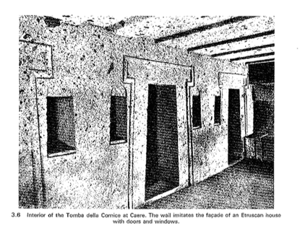

Slide 9
The Etruscans
Their religion, art, and lifestyle was greatly influenced by the Greeks
Excelled at sculpted terracotta figures that were brightly painted
Religion became gloomy and cruel
Offered human sacrifices
Set victims off to kill each other in duels, modeling the future Roman gladiatorial contests

Slide 10
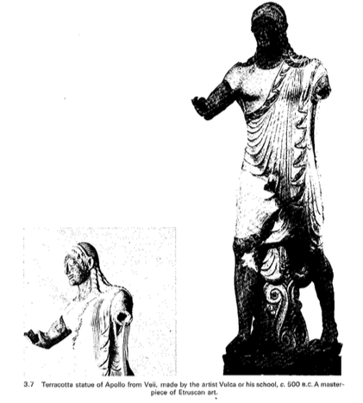

Slide 11
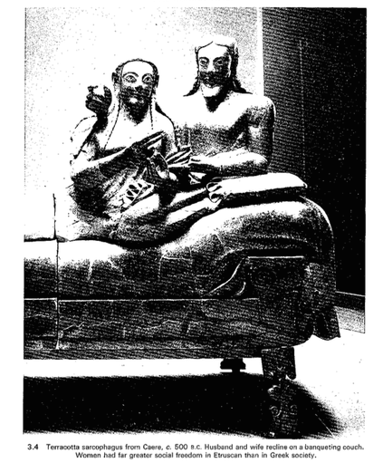

Slide 12
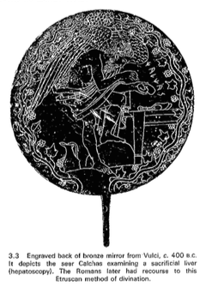

Slide 13
Etruscans
Etruscan cities often centered around arenas which served as sporting venues
City-states that were ruled by kings, then by the aristocracy
City-states linked in a League of Twelve Cities, but were still more loyal to their city-state
A very opulent culture
Fought with the Greeks, the Phoenicians, the Celts, the Gauls
Did maintain control of the Italian peninsula and it’s wealth
Etruscan failure to provide a firm hold over their land
Romans adopted various Etruscan customs and practices after conquering them in 509 B.C.

Slide 14
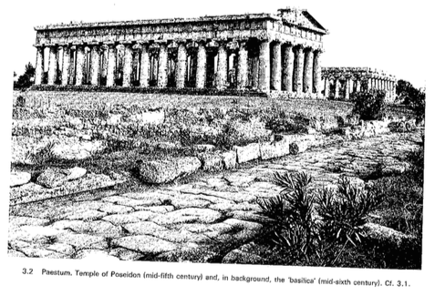

Slide 15
Latium
Lived in the cradle of Rome, on the coastal plain of the Tiber
Known as ‘Latins’
They appear to be one of the youngest of Italian peoples.
Culture was influenced by the arrival of the Etruscans as well as had some Greek influences (whether these influences came directly from the Greeks or through the Etruscans, we don’t know)

Slide 16
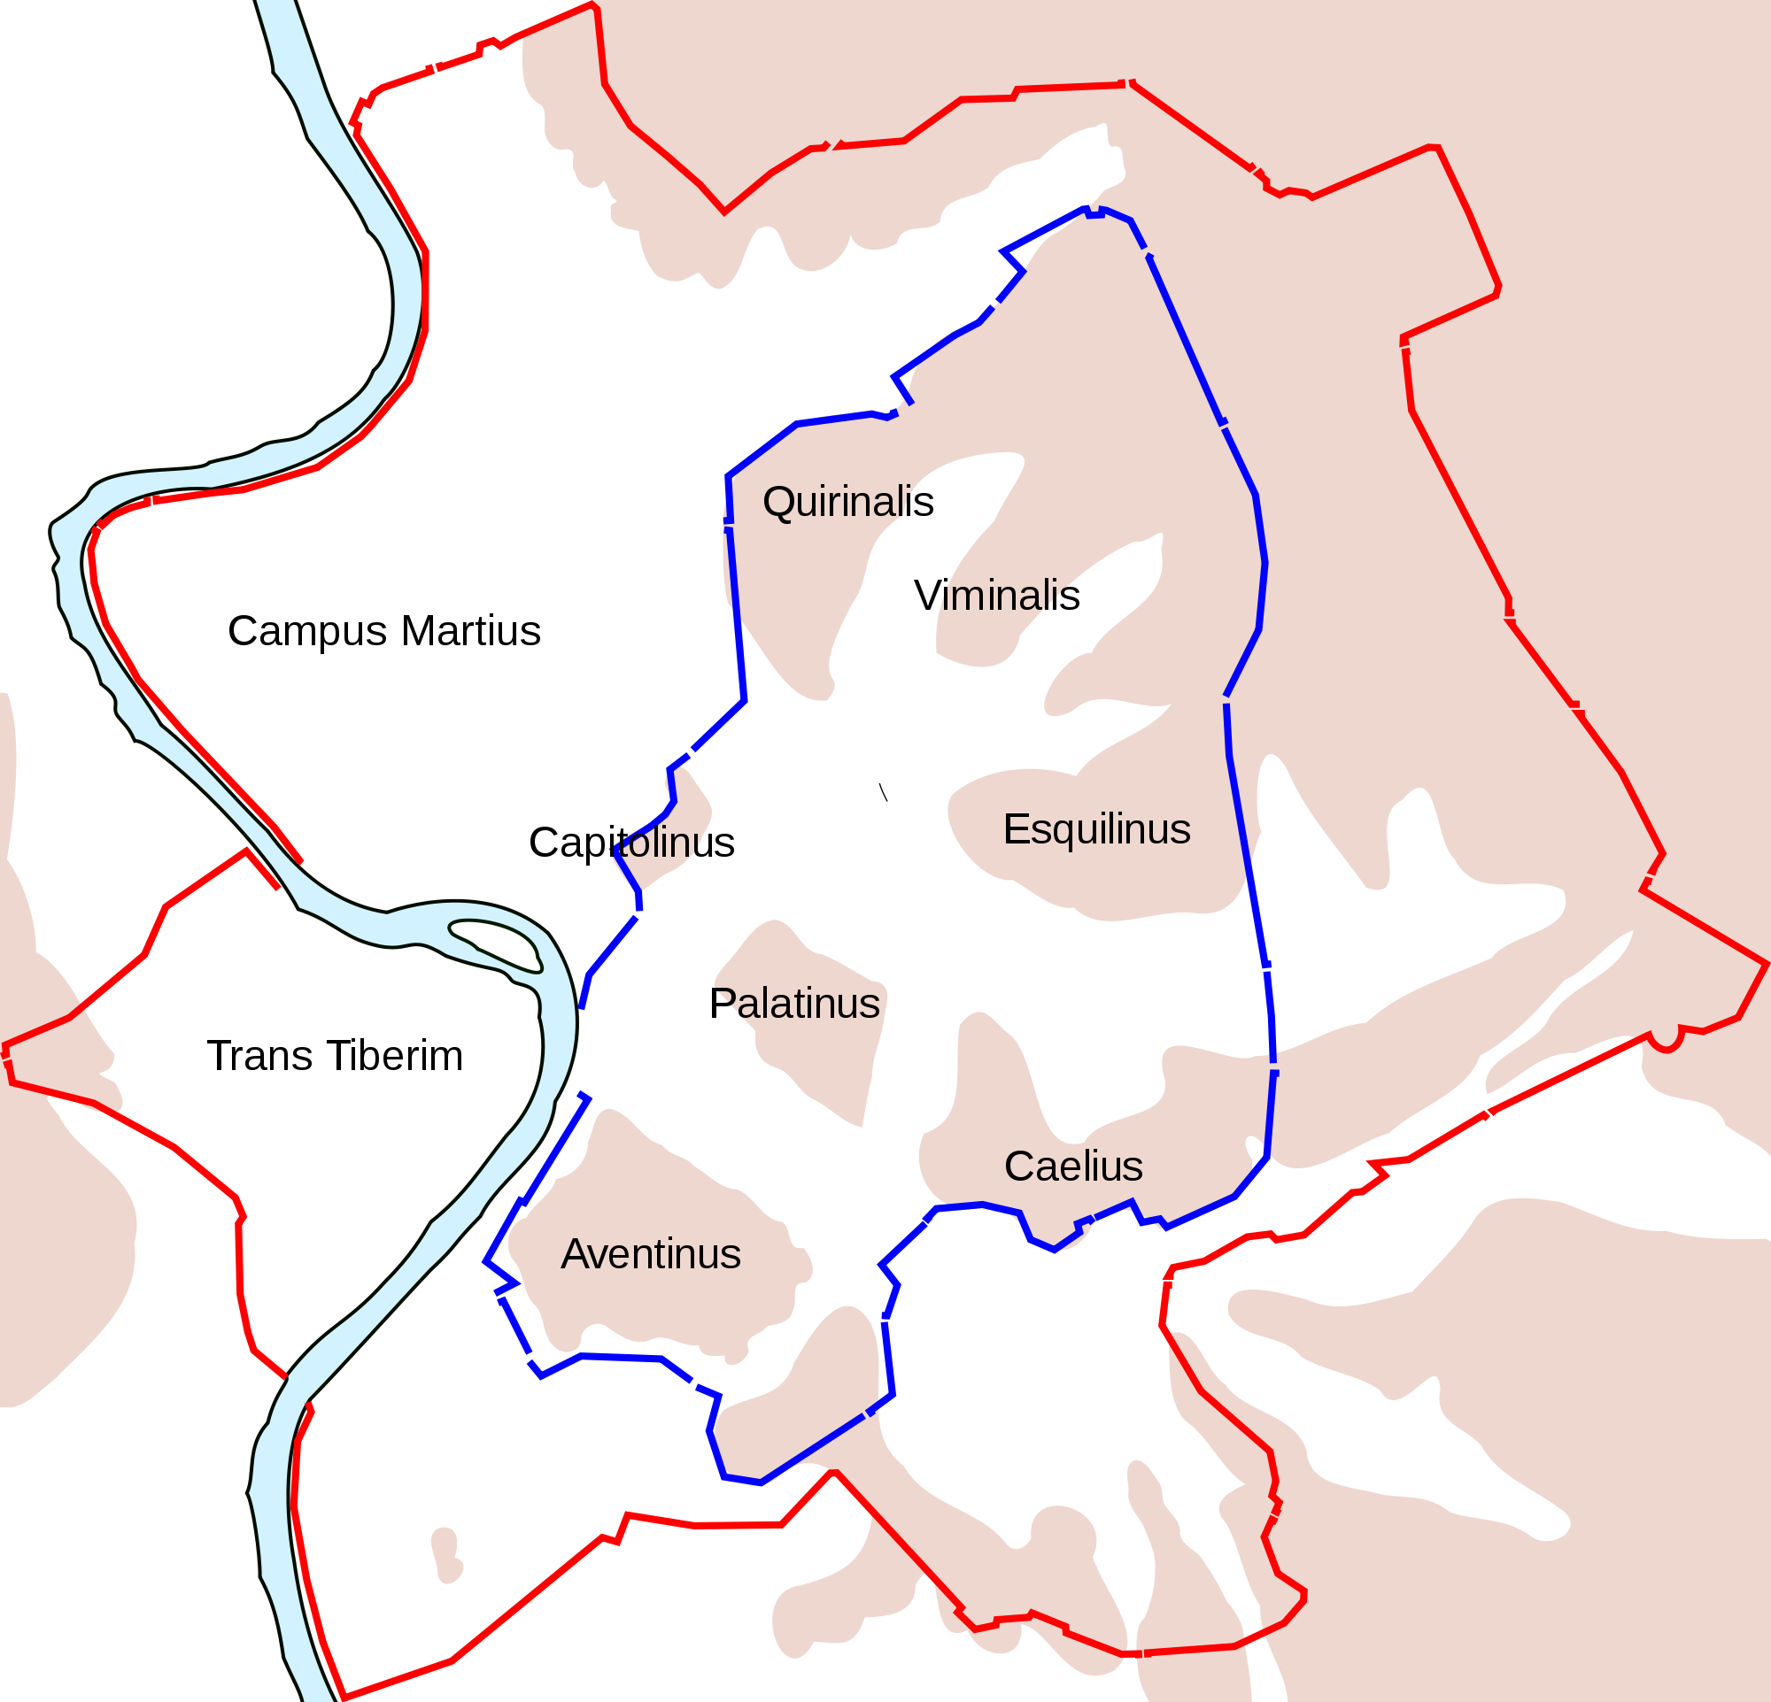
The Creation of Rome
Notes:
Red line: Aurelian Wall (built 271-275 AD)
Blue: Servian Wall (4th century BC)

Slide 17
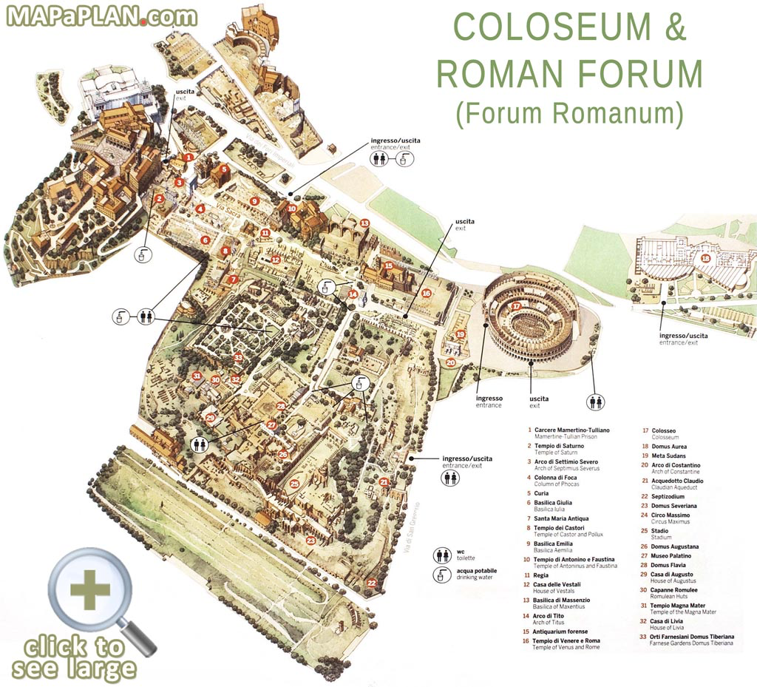

Slide 18
