Slide 1
Roman Sport Early
Early Republic: people kept physically fit and engaged in athletic contests but were not interested in Greek-style formal athletic competition
Upper class developed ball games, massage, thermae (bathing pools)
Some wealthy Romans accepted the Greek concept of health gymnastics
Honored their gods through physical activities
Foot races, ball playing, equestrian displays, and wrestling

Slide 2
Change Over Time Late
Less interested in personal physical fitness
Rome became a nation of spectators
Mass entertainment, spectacle, and carnage

Slide 3
Roman Sport and the Military
Military extremely important
Affected views of physical training
Youth were trained to make obedient, disciplined soldiers
Prestigious profession
Legions were feared throughout ancient world
Stoic philosophy supported military system
Notes:
Graphic taken from sample Instructor Resource CD (McGraw-Hill publisher) sent to me as an example (author: Angela Lumpkin)

Slide 4
Roman Science: Claudius Galen
Practiced on gladiators
First to apply medicine and biomechanics to exercise.
Opposed to professional athlete
Agreed with Greeks about “moderation in all things”
Notes:
Graphic taken from sample Instructor Resource CD (McGraw-Hill publisher) sent to me as an example (author: Angela Lumpkin)

Slide 5
Women and Sport
Women’s role not nearly as documented as men’s role
for entertainment value; not taken seriously
Athletic competition was the domain of Roman men
Women participated in swimming, dancing, ball games, and thermae

Slide 6
Women and Sport
“Romanized” Olympic Games had wrestling and running contests for women
Archaeological evidence that women competed as gladiators
Roman officials outlawed participation at certain times
Notes:
Graphic from sample Instructor Resource CD (McGraw-Hill publisher) sent to me as an example (author: Angela Lumpkin)

Slide 7
Games and Spectacles
Religious holidays became elaborate festivals
53 public holidays in 173 B.C.; nearly 200 by 300 A.D.
Politicians often funded spectacles to get voter support
Spectacles took place frequently to pacify the people
Government believed bored citizens would revolt
Included gladiatorial fights, horse and chariot races, and various other forms of combat

Slide 8
Games and Spectacles: Arenas
Flavian Amphitheater (Colosseum)
Engineering marvel; scented water cooled spectators
Food and presents thrown to poor
Space for 50,000 spectators
Typical agenda:
Animal fights
Men and women thrown to the animals
Gladiator fights last and most popular
Mass combats also held
Emperor Claudius (A.D. 52) flooded Colosseum and ordered 19,000 slaves onto ships

Slide 9
Flavian Amphitheater
Notes:
Exterior of the Colosseum (Flavian Amphitheater), Rome; the Colosseum was built in about 72-80 A.D.
Image source: Royalty-Free/CORBIS, courtesy of McGraw-Hill Higher Education

Slide 10
Flavian Amphitheater
Notes:
Interior of the Colosseum (Flavian Amphitheater), Rome. The floor of the arena was wood, covered by sand, but it could also be flooded for the reenactment of naval battles. Below the floor of the arena, and visible today, is the Hypogeum, a network of tunnels, rooms, and cages where gladiators and animals were held before contests.
Image source: Royalty-Free/CORBIS, courtesy of McGraw-Hill Higher Education

Slide 11
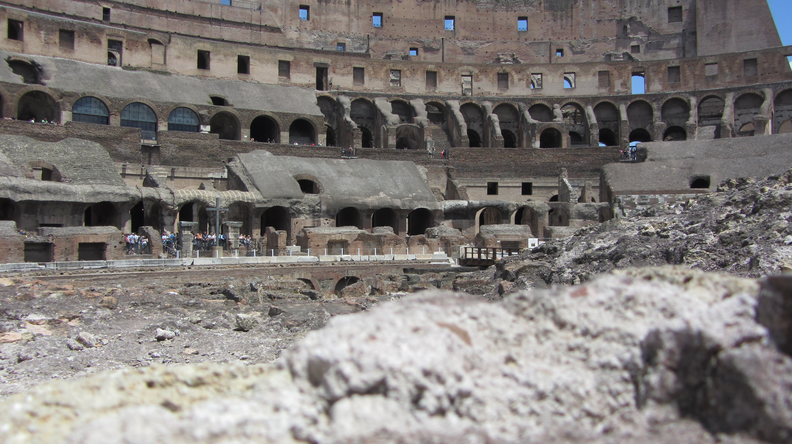

Slide 12
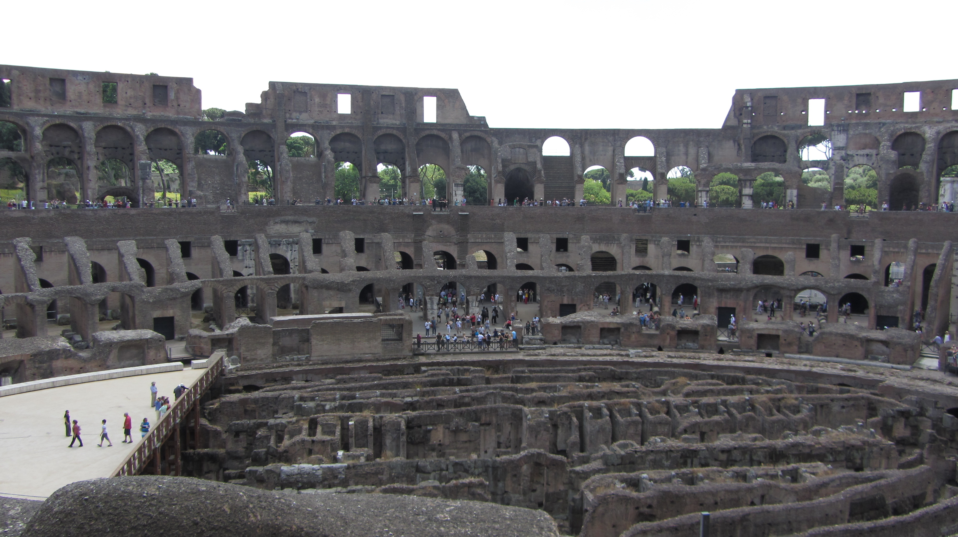

Slide 13
Games and Spectacles
Circus Maximus: premier hippodrome in Rome
Chariot races, gladiator combats in front of 250 thousand spectators
More Christians were killed in the Circus Maximus than in the Flavian Amphitheater
Notes:
Graphic from sample Instructor Resource CD (McGraw-Hill publisher) sent to me as an example (author: Angela Lumpkin)

Slide 14
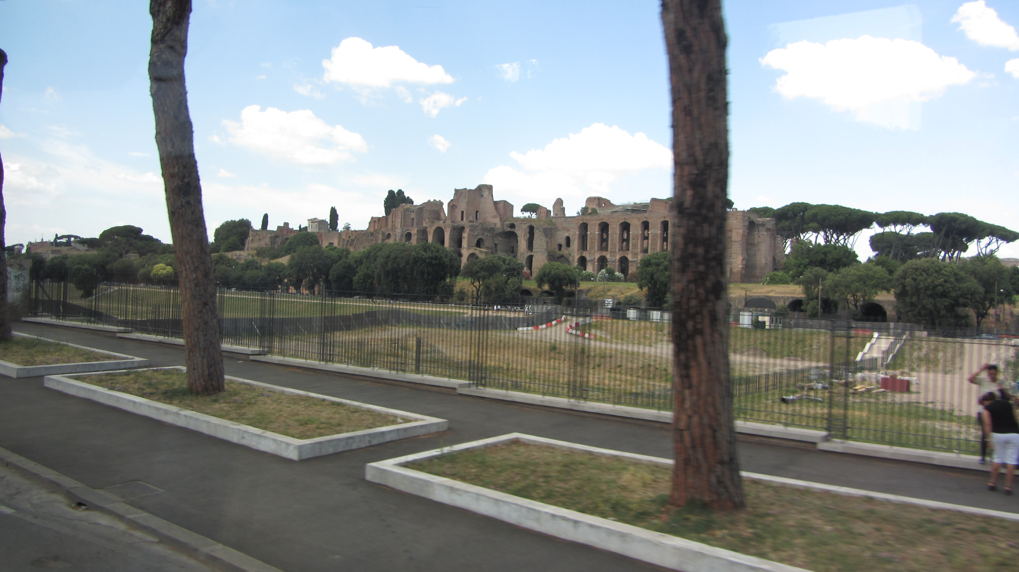

Slide 15
Chariot Races
Notes:
Sketch of a Roman Chariot Race from the novel Ben Hur.
Image source: Library of Congress Prints and Photographs Division, Washington, D.C.

Slide 16
Games and Spectacles: Gladiators
Mostly criminals and slaves trained to fight
Utilitarian approach of pacifying the people
System dealt with “criminals,” political enemies
Some free men volunteered: auctorati
Most popular events
Notes:
Graphic from sample Instructor Resource CD (McGraw-Hill publisher) sent to me as an example (author: Angela Lumpkin)

Slide 17
Sport and Christianity
Christianity’s growth profoundly impacted sport
Roman “sport” was condemned by Christians writers
Christians were often victims of the spectacles
Christians urged to avoid sport and games—but they did attend and gamble on events
Extent of Christian participation in sport and games is debated

Slide 18
Sport and Christianity
Christian Empire adopted popular chariot racing from the Romans
Greek athletic festivals and Roman spectacles ended with destruction of Rome

