Slide 1
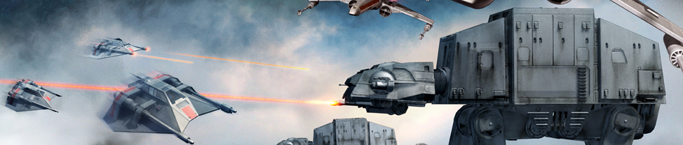
Spain Builds An Empire
As Columbus was searching for a western route to India and Asia, Spain was building up their empire. Adventurers, explorers, and conquistadors left the ports of Spain for the new land in hopes of glory and gold. It would be the greedy and ruthless. Individuals interested in getting rich quick rather than making peace with Indian tribes.

Slide 2
Vocabulary
The following are terms and definitions you’ll need to know. Some of the terms might be familiar, but others won’t so study them all.

Slide 3
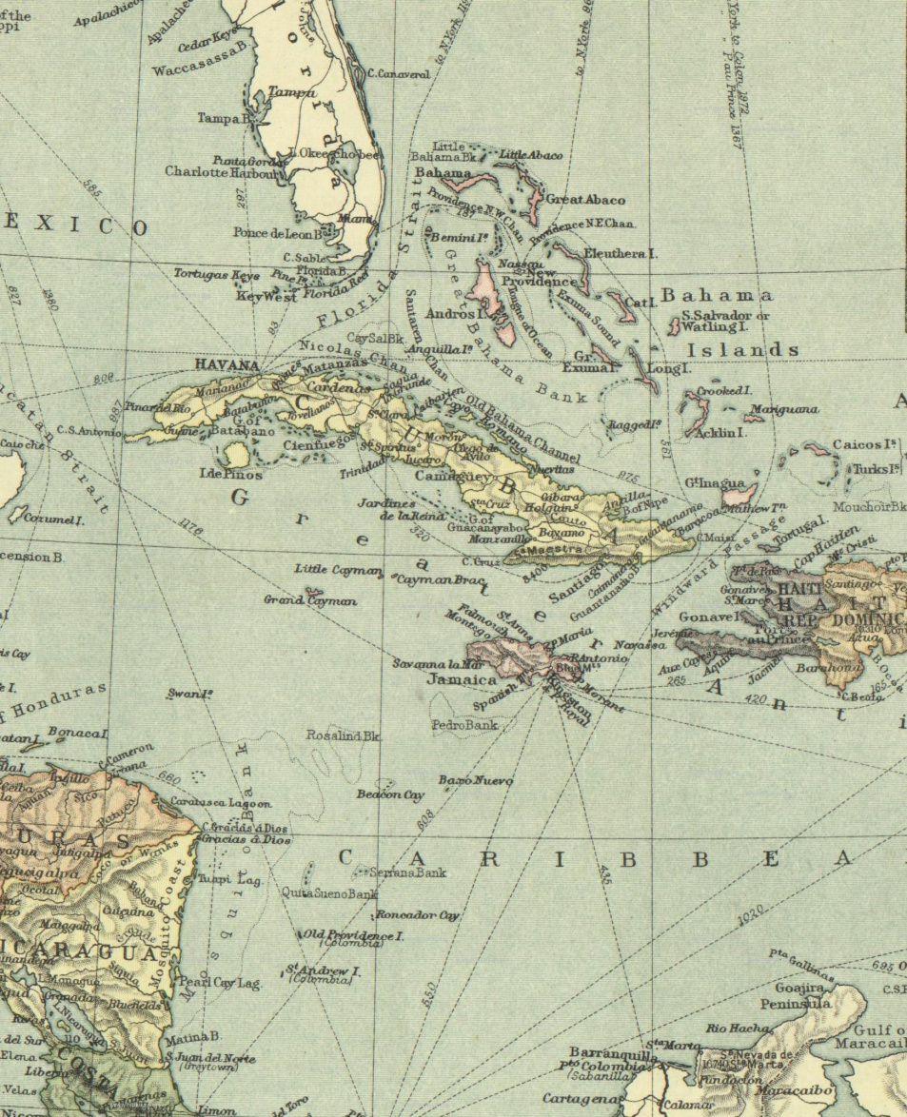
Conquistador: Spanish word for conqueror.
West Indies: Another word for the Caribbean Islands.
Borderlands: The lower portion of the United States today. Spanning across Florida to California.

Slide 4
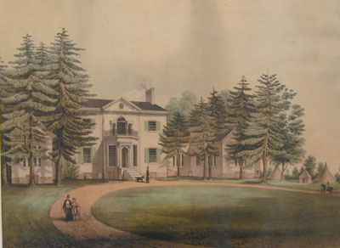
Presidios: A fort where soldiers lived in the Spanish colonies.
Plantation: A large estate farmed by many workers, usually slaves.
  Think “Gone With The Wind.”

Slide 5
Adventurers & Explorers
Who would become famous? And who would erase thousands of years of culture from the face of this earth in a matter of months?

Slide 6
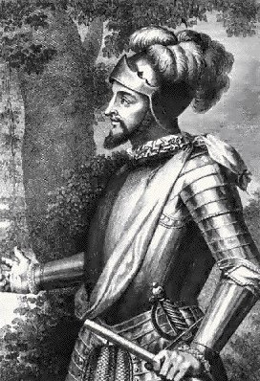
1513: Vasco Nunez de Balboa
He made his way through present-day Panama.
After 25 days, he came out of the jungle to see the Pacific Ocean.
He will claim the ocean for Spain.
Has the United States ever done this?

Slide 7
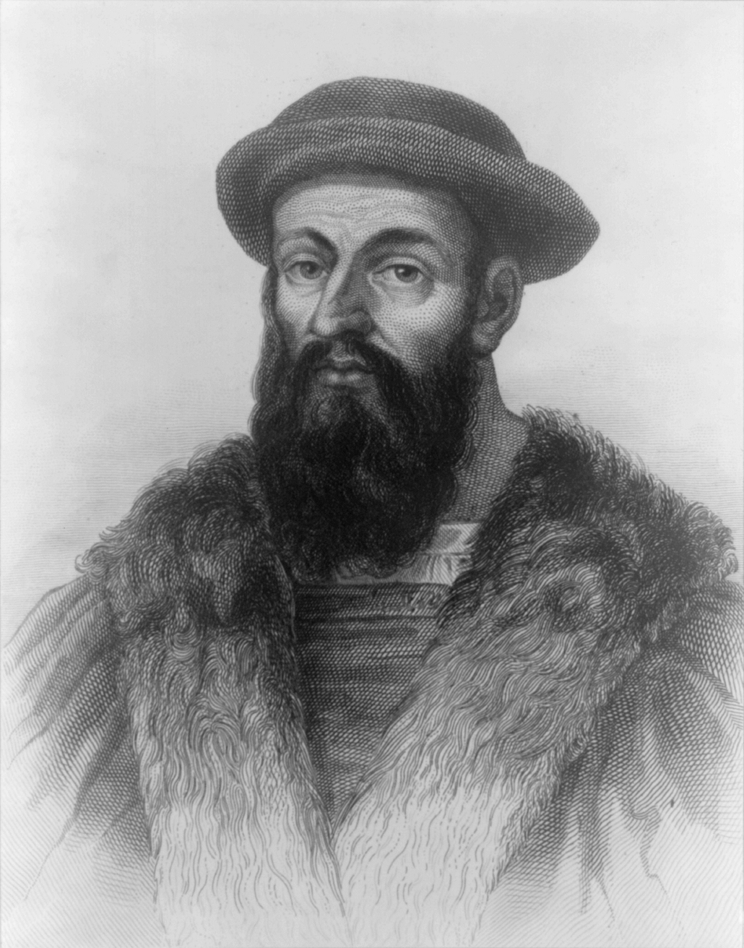
1519: Ferdinand Magellan
Magellan and his crew head to the East Indies.
When they ran out of food, they ate rats and sawdust.
Out of 5 ships and about 250 crew members, only one ship and 18 sailors returned to Spain in 1522. Three years after they set out.
They made the record books.

Slide 8
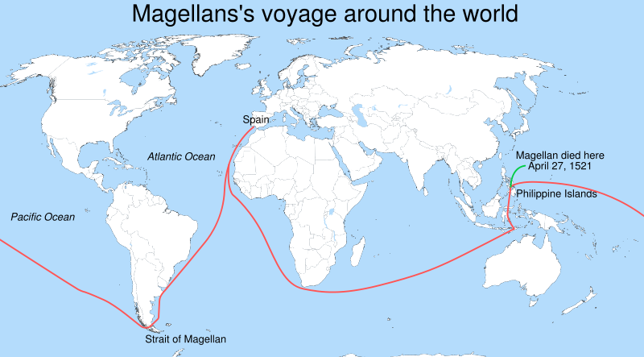

Slide 9
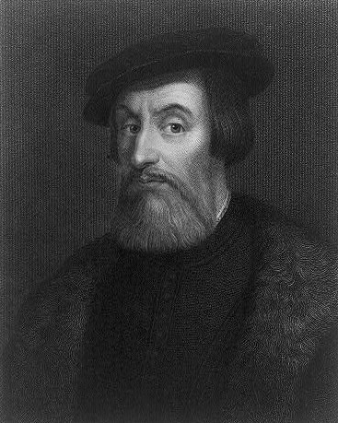
1519: Hernando Cortes
Cortes and his men arrive in present-day Mexico.
The Aztec were waiting.
  A large house floating on the sea.
  It was filled white men with long, thick beards.
Lets review the background behind the Aztec.

Slide 10
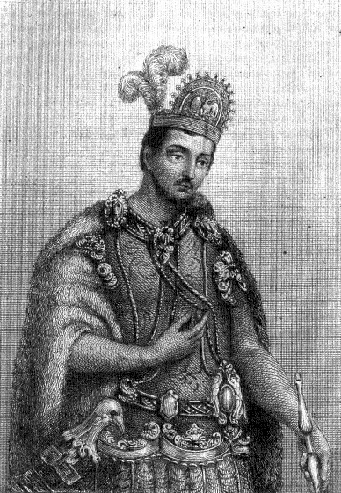
A prophecy
  Aztec legend predicted that a powerful white-skinned god would come from the east to rule over them.
  Because of this Montezuma welcomes Cortes with open arms.
Montezuma is imprisoned for 6 months.
Shortly after his rescue, the Spanish overthrow the Aztec for good.

Slide 11
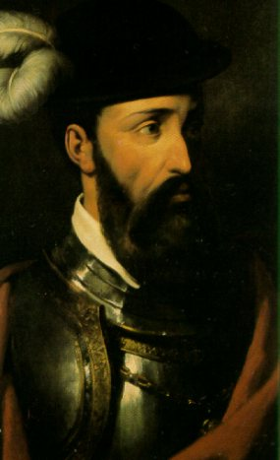
1532: Francisco Pizarro
He traveled with Balboa across Panama.
He then set sail south.
He’s the guy who captured Atahualpa, the Inca emperor, and many of his soldiers.
Later he will execute Atahualpa. Strangled.
Without Atahualpa, the Inca fall to the Spanish.

Slide 12
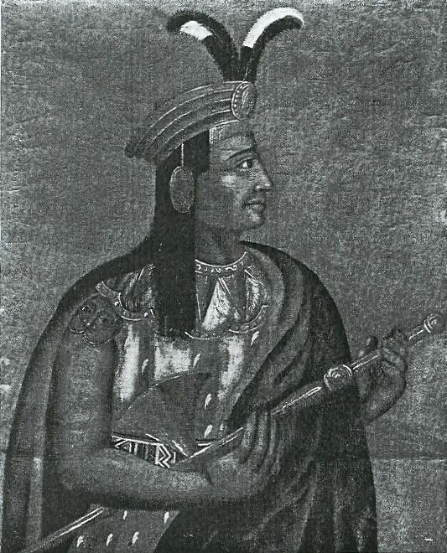
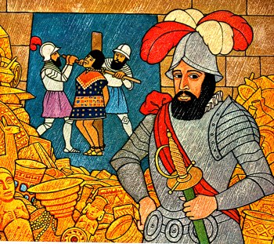

Slide 13
Reasons For Spanish Victories
(1) The Spanish had superior military equipment. (2) They also were protected by steel armor and of course they had guns.

Slide 14
Reasons For Native Losses
The following are the main reasons why the Native Americans lost their fight against the Spanish.

Slide 15
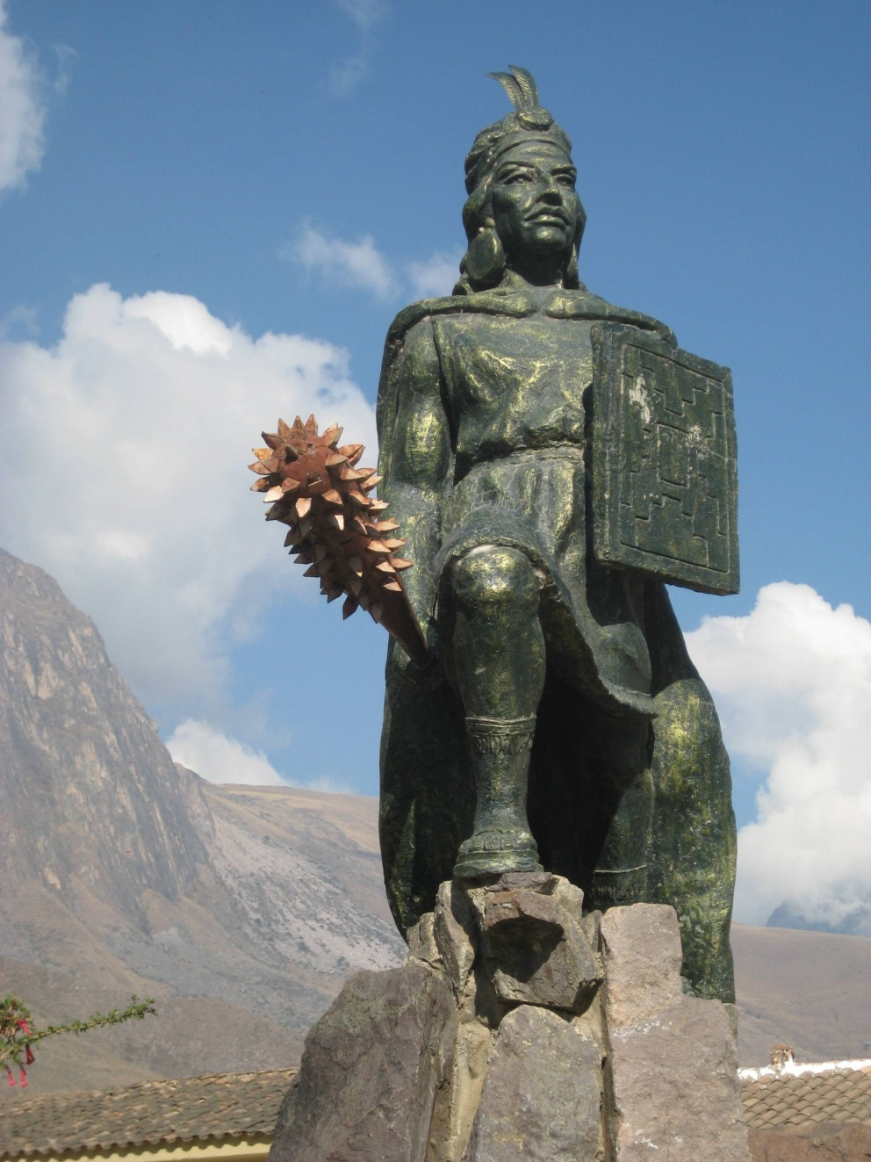
Relied on clubs, bows and arrows, and spears.
Never had seen a horse before.
Slow to fight due to the prophecy.
Fell victim to European diseases:
  Chicken Pox
  Measles
  Influenza

