Slide 1
Chasing After Ghosts
Who would go mad searching for a fountain of youth or mysterious cities of gold?

Slide 2
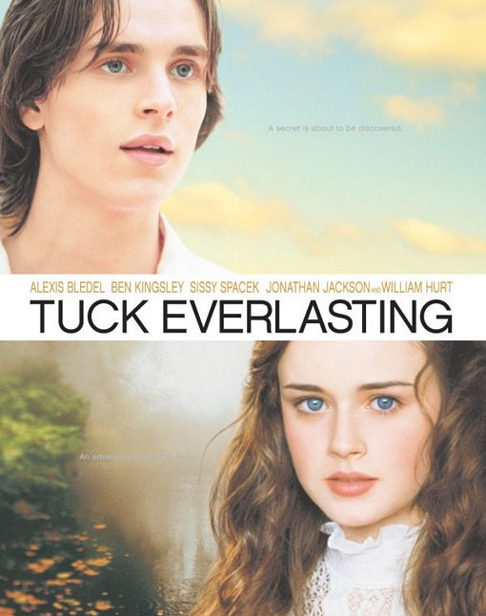
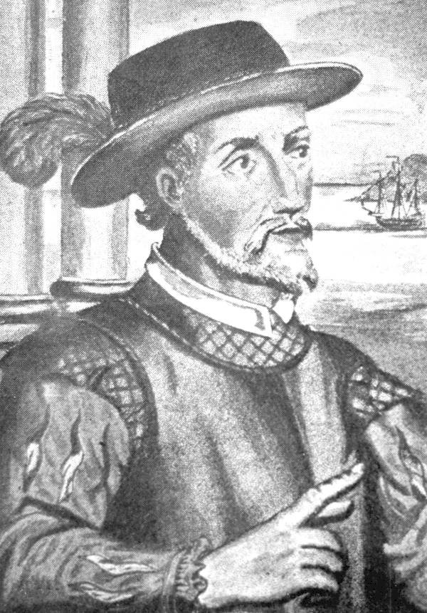
1512: Juan Ponce de Leon
Traveled through parts of Florida looking for the legendary “Fountain of Youth.”
Compare this to the novel Tuck Everlasting.
Remember Pirates of the Caribbean: On Stranger Tides?

Slide 3
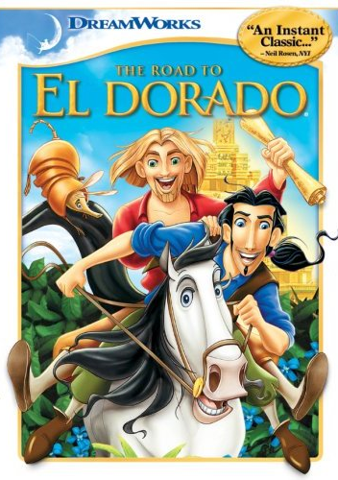
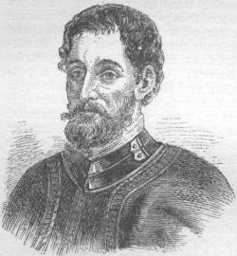
1539 to 1542: Hernando de Soto
Traveled through parts of the southeastern borderlands looking for the “Mysterious Cities of Gold.”
Seven cities whose streets were paved with gold.
Compare this to El Dorado.

Slide 4
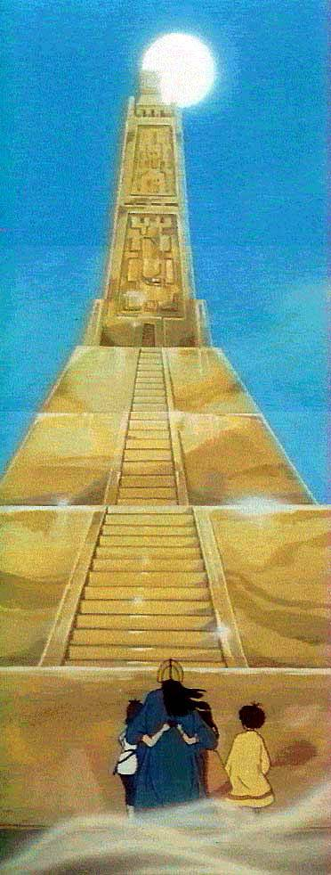
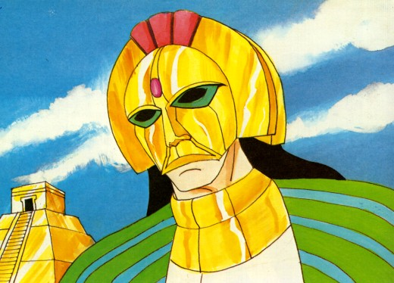

Slide 5
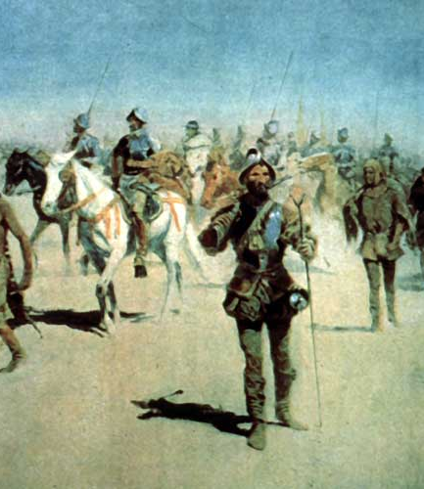
1540: Francisco Coronado
Continued Hernando de Soto’s search.
Traveled through parts of present-day Arizona and New Mexico in search of the seven cities of gold.
Died without finding anything, but a few pieces of gold jewelry.

Slide 6
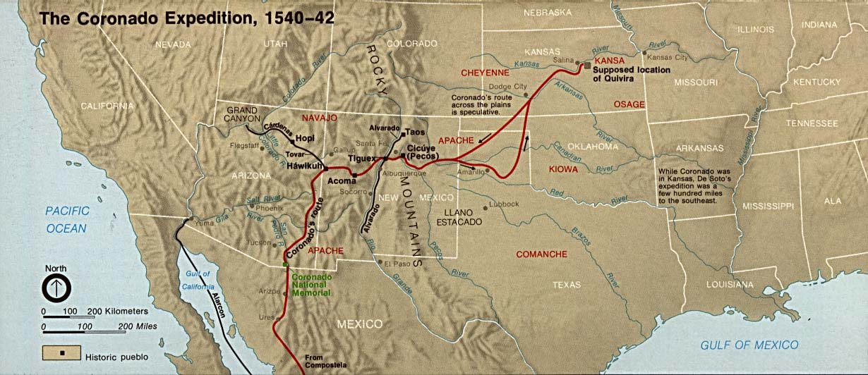

Slide 7
The Treatment Of Natives
As the king of Spain divided up his land in the Americas so it would be easier to govern, he appointed Viceroy’s to enforce the laws. A series of laws called “Laws of the Indies” were created.

Slide 8
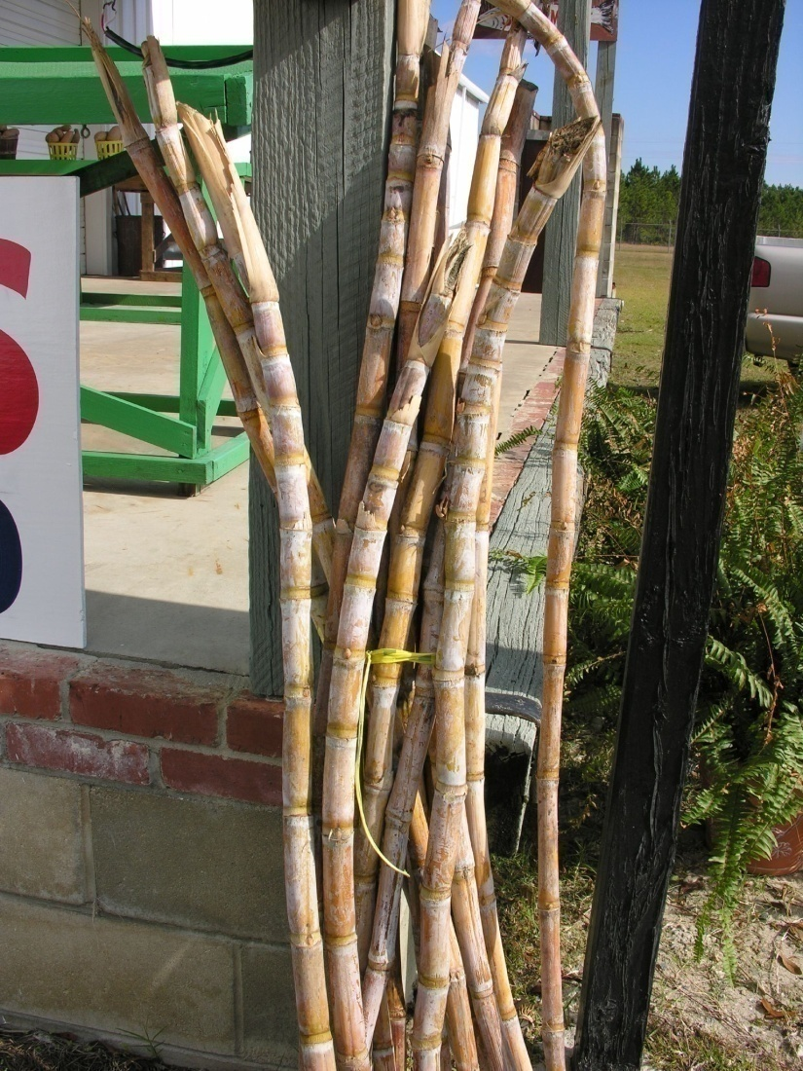
Native Americans
Gold and Silver Mines
  Many Indians were forced to work in the mines.
  As a result, a large portion died when tunnels caved in.
Plantations
  Many Indians were forced to work on plantations in the Caribbean.

Slide 9
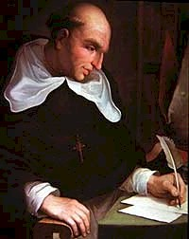
To The Rescue!
Bartolome de Las Casas
  A priest who decides to record the abuse of Native Americans. Traveling throughout the Caribbean.
  Travels to Spain to meet with the king. New laws are passed against the treatment of Indians. No one pays attention.

Slide 10
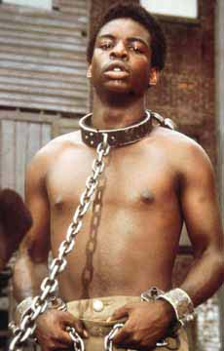
Because the Viceroy’s would not listen, Las Casas suggested a new group of people to be slaves.
He suggested Africans.
  Africans did not catch European diseases.
  They were used to doing hard farm work.
He would regret his suggestion later in life.

Slide 11
Talking Points (review)
Define West Indies.
Define plantation.
How many days did it take Balboa to cross the jungle of Panama?
Where did Magellan die?
What is Magellan’s surviving crew known for?
Tell me the Aztec legend of settling in Mexico?
What is the Aztec king’s name?
What is the Inca king’s name?
Tell me what the Inca king promised? Did it work?

Slide 12
Talking Points Continued (review)
What are two of the four reasons behind why the Indians lost against the Spanish?
Who was looking for the “Fountain of Youth?”
What two people were looking for the “Mysterious Cities of Gold?”
What is a Viceroy?
Who were the first group of people enslaved by the white men?
Why didn’t this work out?
Who suggested to use Africans instead?

