Slide 1
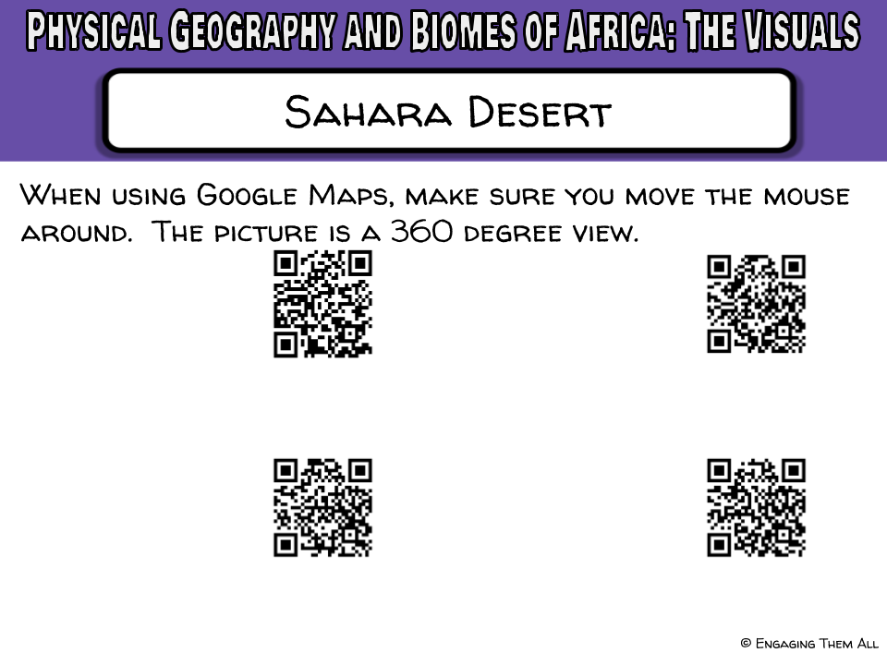
Google Maps https://goo.gl/fiErgT | Google Maps https://goo.gl/VQXRnA
Google Maps https://goo.gl/8uVCwc | Google Maps https://goo.gl/5dDbc3

Slide 2
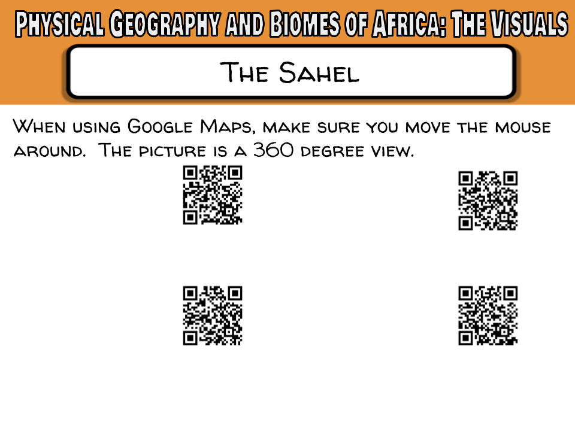
Google Maps https://goo.gl/sNKcvr | Google Maps https://goo.gl/TV0PKV
Google Maps https://goo.gl/Tt9MPQ | Google Maps https://goo.gl/VRg6DL

Slide 3
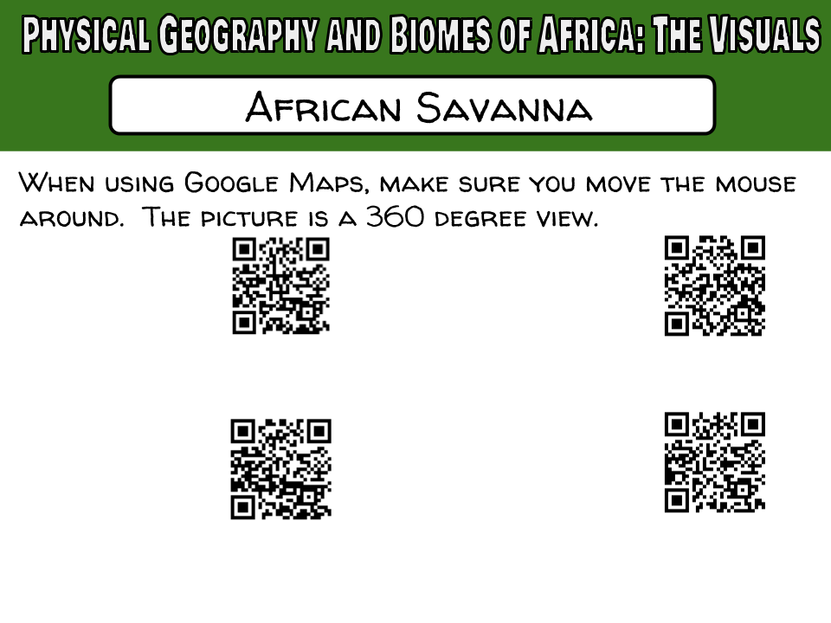
Google Maps https://goo.gl/9r82FX | Google Maps https://goo.gl/pQScCD
Google Maps https://goo.gl/1w7htX | Google Maps https://goo.gl/W72hJ7

Slide 4
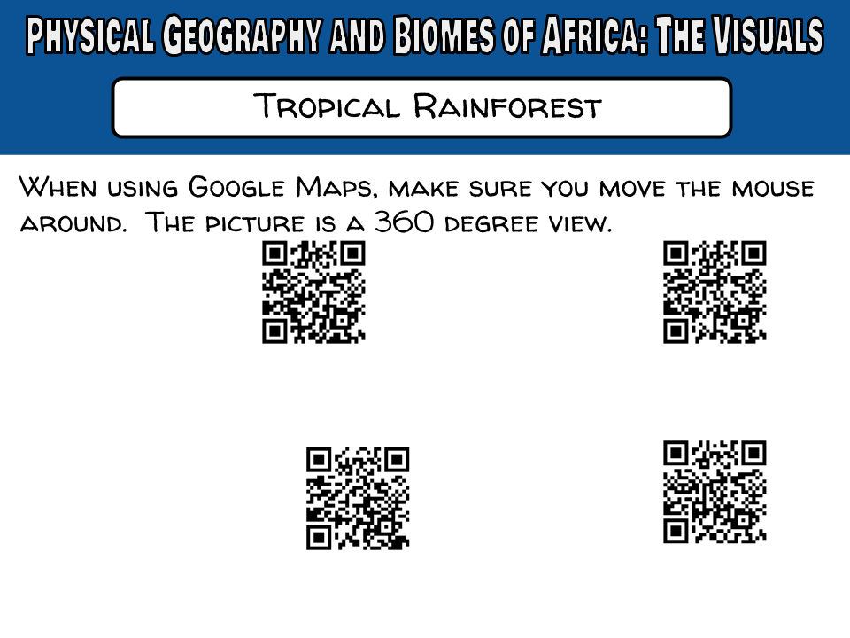
Google Maps https://goo.gl/mMdzNZ | Google Maps https://goo.gl/MoJ3nA
YouTube 360° Video https://goo.gl/RPk8Un | Google Maps https://goo.gl/UFg2e5

Slide 5
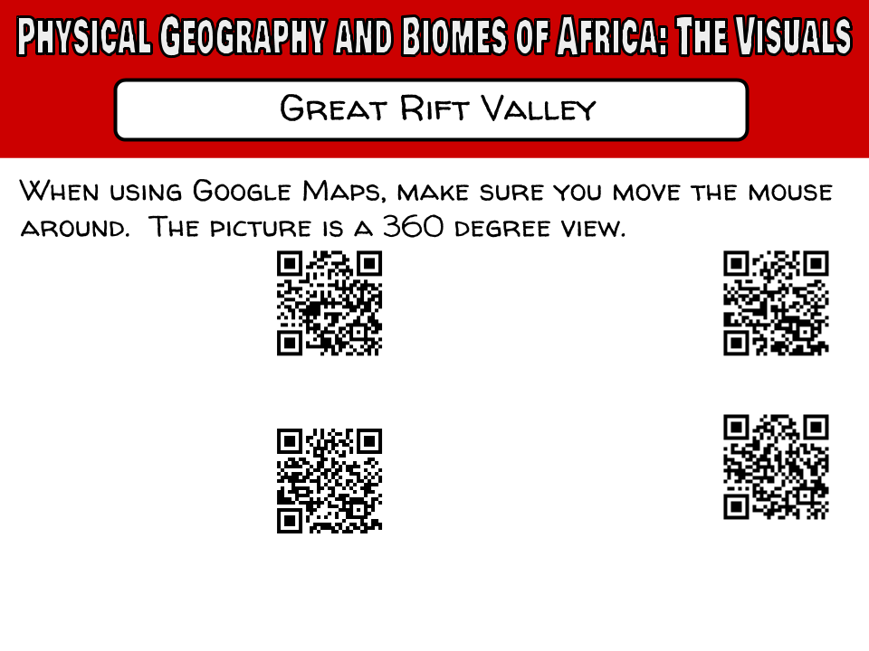
Google Maps https://goo.gl/rvfBbD | Google Maps https://goo.gl/NX8X4T
Google Maps https://goo.gl/xttVKY | Google Maps https://goo.gl/XdtIdK

Slide 6
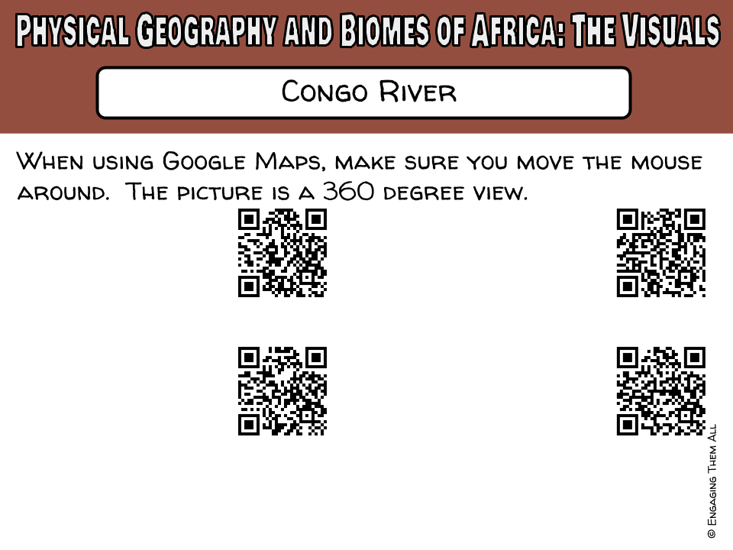
Google Maps https://goo.gl/MUfSUw | Google Maps https://goo.gl/Hn1y7M
Google Maps https://goo.gl/Oho25U | Google Maps https://goo.gl/Jzthk8

Slide 7
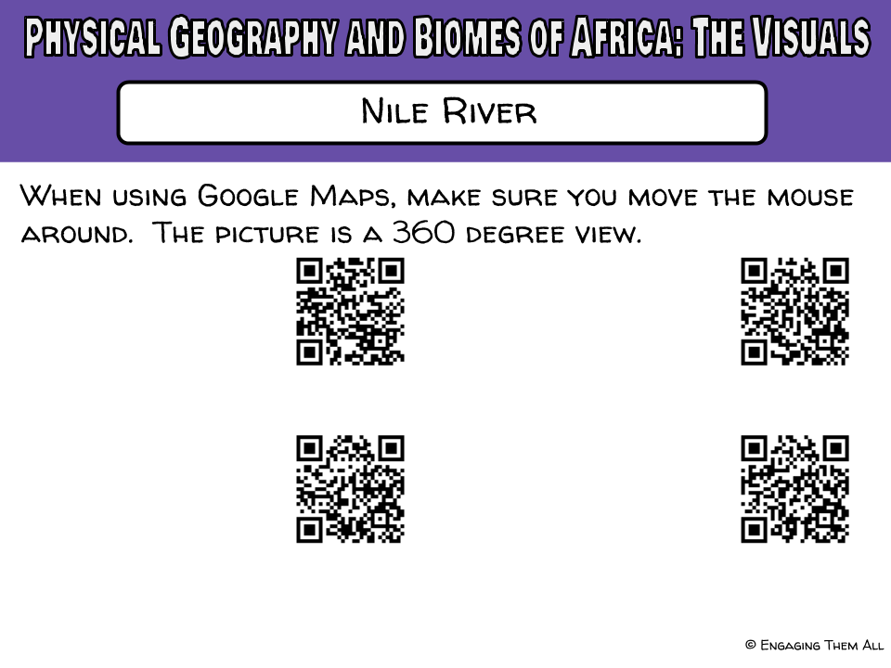
Google Maps https://goo.gl/0GTS9z | Google Maps https://goo.gl/n3jS9r
Google Maps https://goo.gl/PQcGlv | Google Maps https://goo.gl/DES1O2

Slide 8
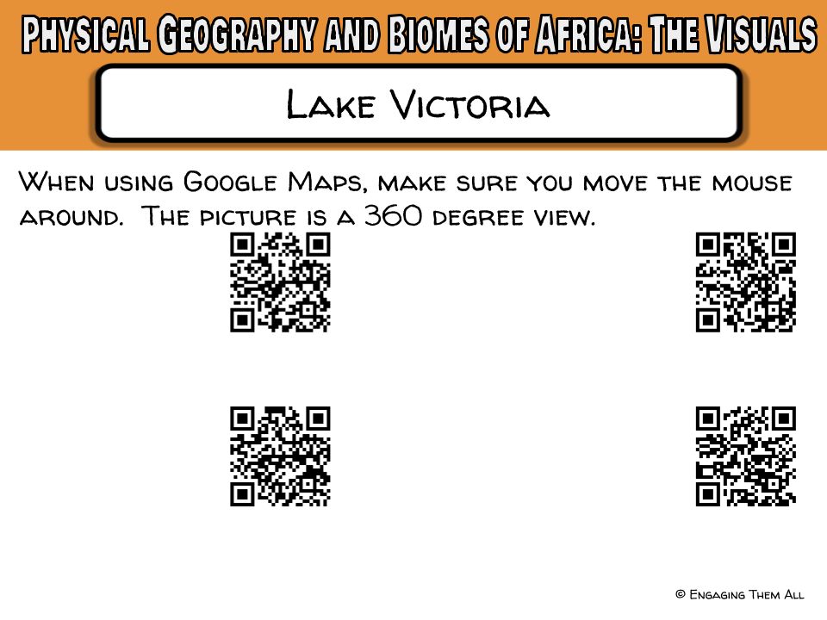
Google Maps https://goo.gl/2fte3T | Google Maps https://goo.gl/rBCXIr
Google Maps https://goo.gl/sM31yj | Google Maps https://goo.gl/uXfs0Q

Slide 9
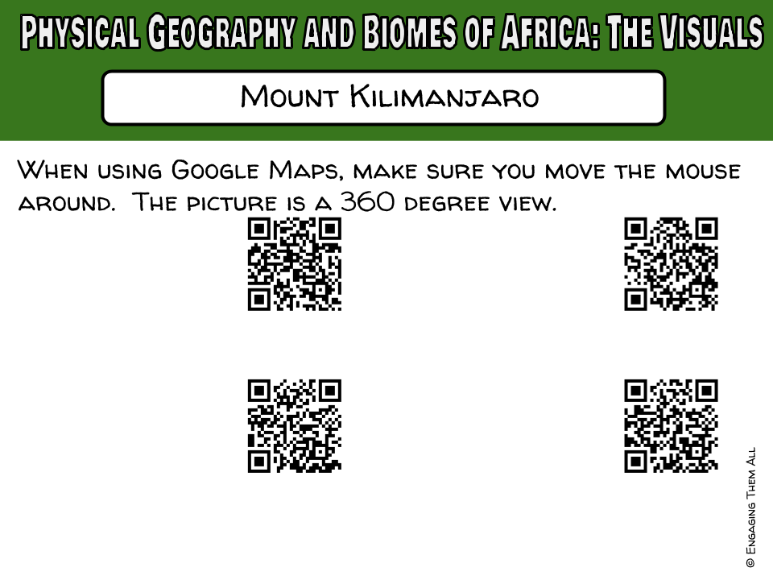
Google Maps https://goo.gl/kOMEIb | Google Maps https://goo.gl/NnvqFR
Google Maps https://goo.gl/a3MMTI | Google Maps https://goo.gl/GoKYsh

Slide 10
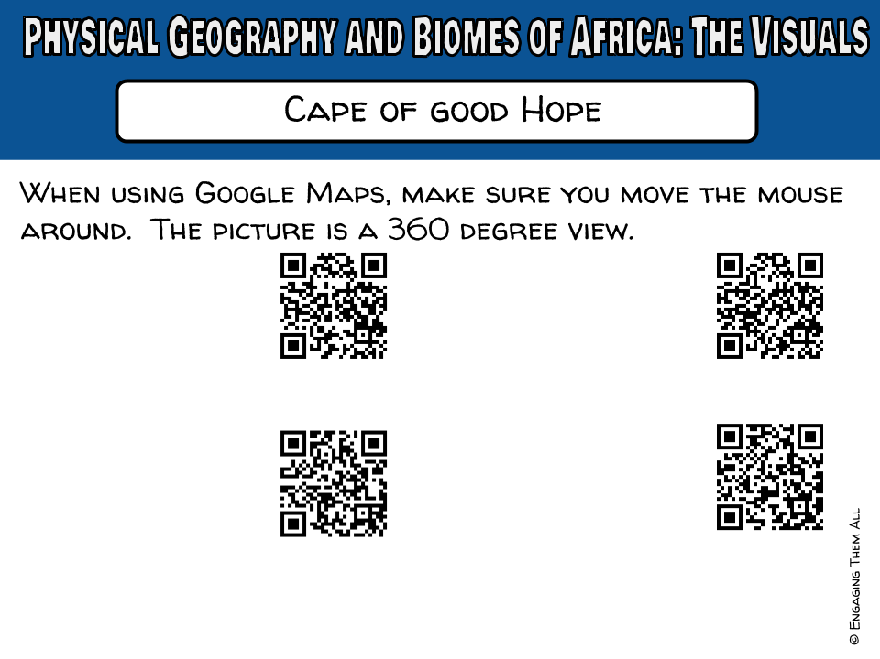
Google Maps https://goo.gl/UBvYwR | Google Maps https://goo.gl/4rbt4d
Google Maps https://goo.gl/dxu1Bu | Google Maps https://goo.gl/cIrH7I

Slide 11
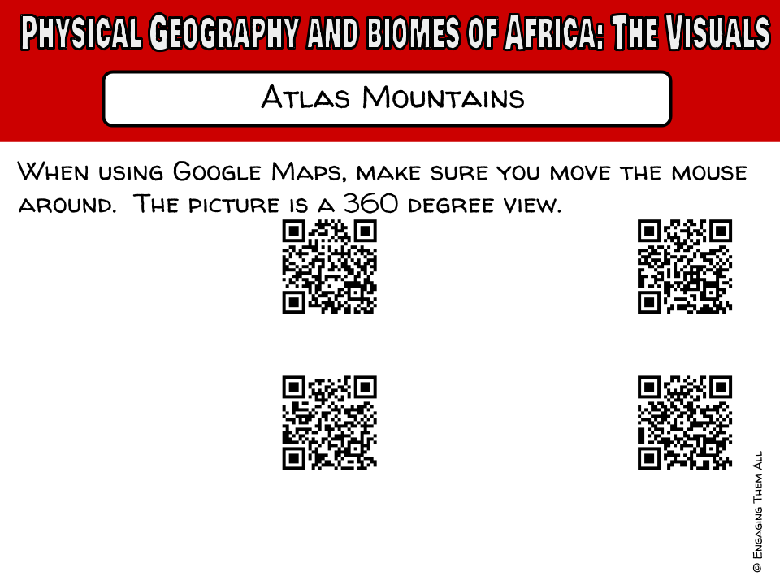
Google Maps https://goo.gl/CRCXNr | Google Maps https://goo.gl/csb4IB
Google Maps https://goo.gl/xAesnI | Google Maps https://goo.gl/X1qGOI

Slide 12
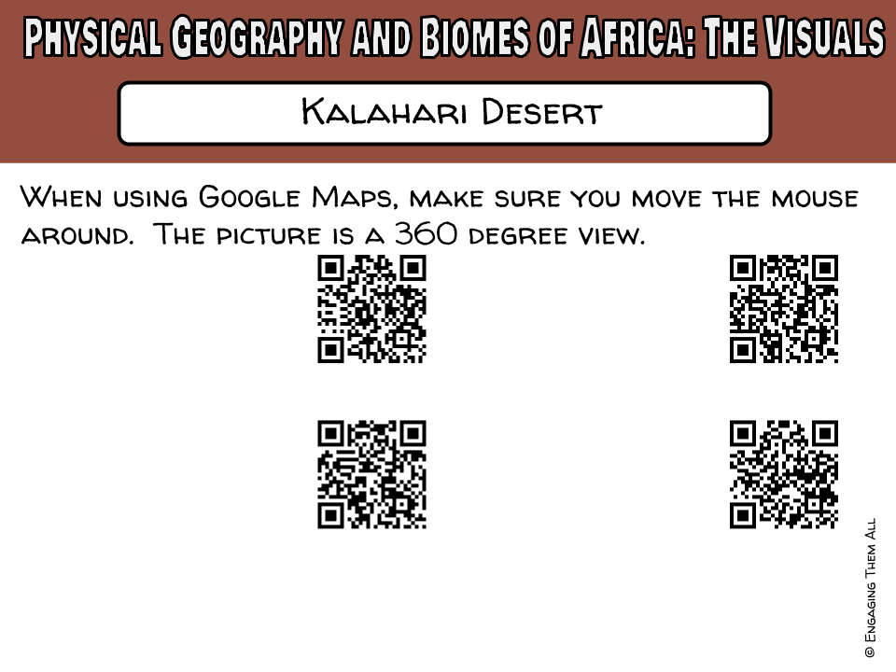
Google Maps https://goo.gl/Yuno1U | Google Maps https://goo.gl/IyX2FH
Google Maps https://goo.gl/UPZlVV | Google Maps https://goo.gl/jllVaK

Slide 13
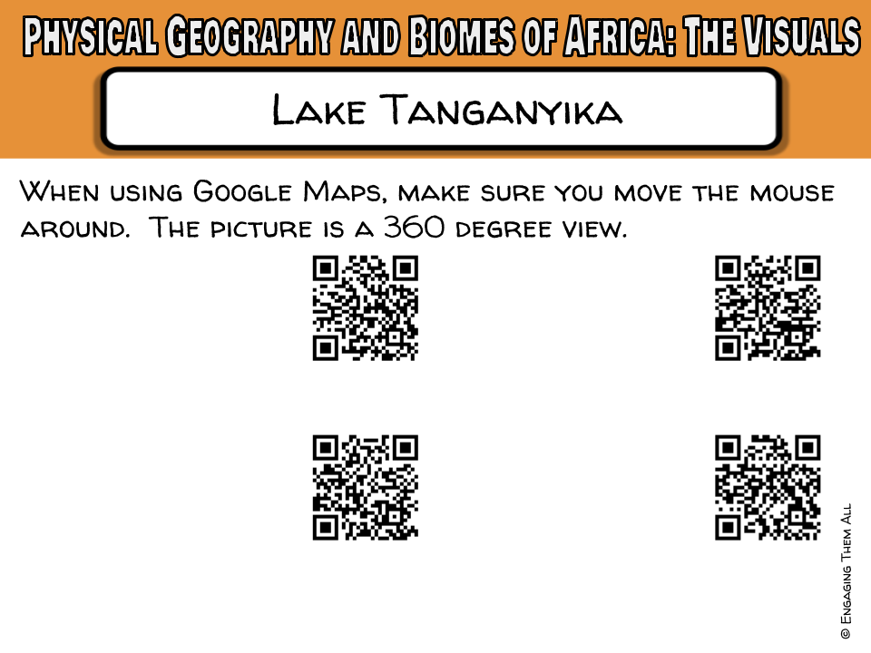
Google Maps https://goo.gl/3gKzyw | Google Maps https://goo.gl/6f1aRP
Google Maps https://goo.gl/KpcrGj | Google Maps https://goo.gl/5sSLZX

Slide 14


Thank you so much for making this purchase! To check out more activities for middle school social studies, and content literacy, visit my Teachers pay Teachers store at:
http://www.teacherspayteachers.com/Store/Engaging-Them-All
To take a peek into my classroom and check out some FREEBIES! Visit my blog, To Engage Them All at: www.toengagethemall.blogspot.com.
Follow me on Facebook at: https://www.facebook.com/ToEngageThemAll
Check me out on Twitter: https://twitter.com/kwilkinstchr
If you have any difficulty with this product, please consider contacting me (engagingthemall@gmail.com) before leaving a rating. I am more than happy to work with you to make your purchase excellent!

