Slide 1
Louisiana Purchase

Slide 2
On April 30, 1803 the nation of France sold 828,000 square miles (2,144,510 square km) of land west of the Mississippi River to the young United States of America in a treaty commonly known as the Louisiana Purchase. President Thomas Jefferson, in one of his greatest achievements, more than doubled the size of the United States at a time when the young nation's population growth was beginning to quicken.

Slide 3
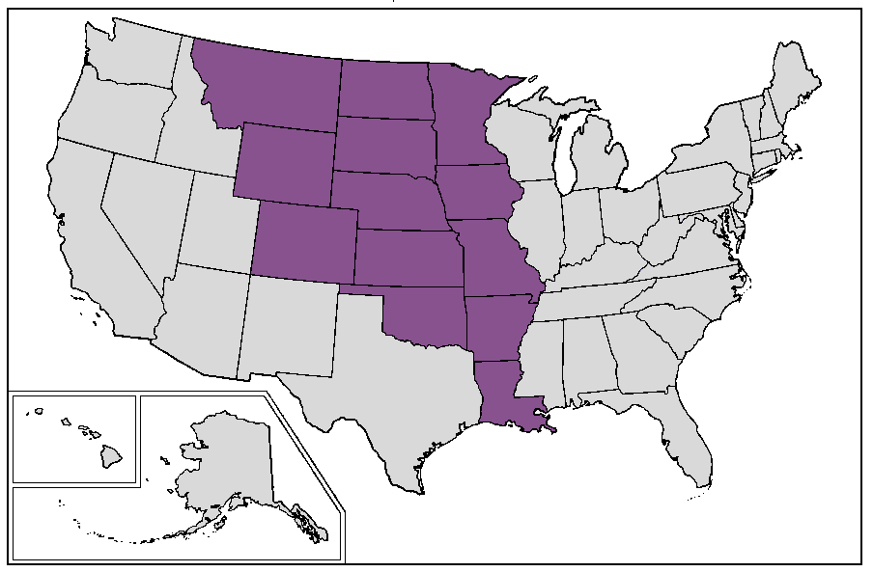

Slide 4
Questions:
Why did we buy it?
Why did the French sell it?
How much did it cost?
What constitutional issues did it have?
Why did Federalists object?

Slide 5
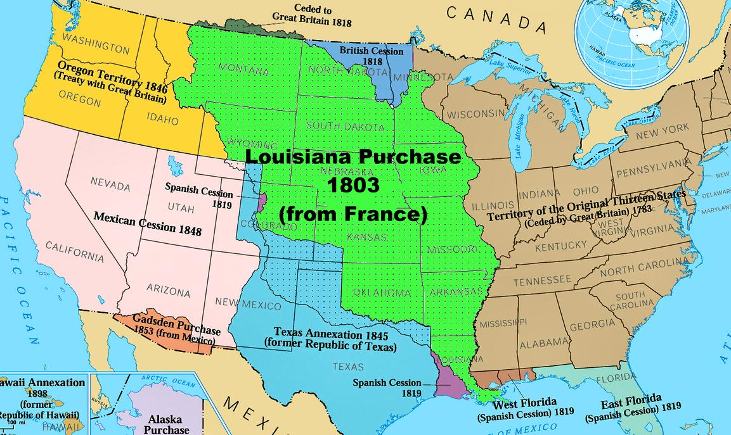
Why did we buy it?
It more than doubled the size of the United States.
The purchase also solidified America’s place as a growing power and challenge to the British, something Napoleon was doubtless aware of and encouraged.
Basically:
-Double size of U.S.
-International political power

Slide 6
Why did the french sell it?
After the French Revolution, Napoleon Bonaparte became the leader of the battered country. Among other things, he envisioned the reestablishment of a new colonial presence in the New World.
A slave uprising led by Toussaint L'Ouverture in Saint-Domingue (the former name for Haiti) dashed those imperial plans.
The only successful slave revolt in history, French forces couldn't quell the Haitian rebellion. Napoleon dispatched 20,000 soldiers to restore peace and order, but a combination of yellow fever and unyielding solidarity among the former slaves defeated the military's efforts. By late 1802, France had lost an estimated 55,000 men. Since Saint Domingue was France's most lucrative colony in the West, Napoleon considered it a key asset for building his Caribbean empire. Cutting his losses, Napoleon abandoned the Western strategy and decided to refill France's dwindling treasury for impending war with Britain.
The United States had already contacted France about buying New Orleans, since it was an important port for the country.
Basically:
-Napoleon needed money to fight his wars in Europe.
-Slave revolt in Haiti: Napoleon gave up idea of Western empire
-The U.S. wanted New Orleans already.
-Slave revolt in Haiti: French afraid of another similar event.

Slide 7
How much did it cost?
The Louisiana Purchase was an incredible deal for the United States, the final cost totaling less than five cents per acre at $15 million (about $283 million in today's dollars). France's land was mainly unexplored wilderness, and so the fertile soils and other valuable natural resources we know are present today might not have been factored in the relatively low cost at the time.
Basically:
-5 cents per acre
-$15 million total (equal to $283 million today)

Slide 8
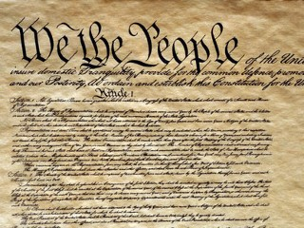
What constitutional issues did it have?
The question of the Louisiana Purchase marked the beginning of a debate over constitutional interpretation that still goes on today. Jefferson and others advocated a strict interpretation of the document, because they wanted to restrict intrusions by the government into the lives of the people. Some thought the treaty was unconstitutional because power to increase the national domain by treaty is not stated in the Constitution of the United States. Nevertheless, the tenth amendment grants to the states and the people all rights not specifically denied in the constitution -- and in any case, the sale went through.
Basically:
-The Big Question: How much power does the Constitution give our government?
-People disagreed about if Jefferson was allowed to make the purchase.

Slide 9
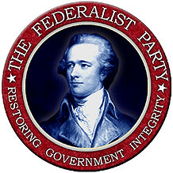
Why did federalists object?
The Federalists strongly opposed the purchase, favoring close relations with Britain over closer ties to Napoleon, believing the purchase to be unconstitutional, and concerned that the U.S. had paid a large sum of money just to declare war on Spain. The Federalists also feared that the political power of the Atlantic seaboard states would be threatened by the new citizens of the west, bringing about a clash of western farmers with the merchants and bankers of New England. There was concern that an increase in slave holding states created out of the new territory would exacerbate divisions between north and south, as well.
Basically:
-Wanted to be friends with Britain, not France
-Thought purchase unconstitutional
-Feared loss of political power
-Feared division of north and south with the rise of more slave states

Slide 10
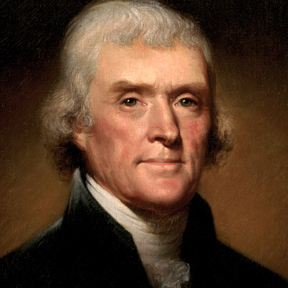
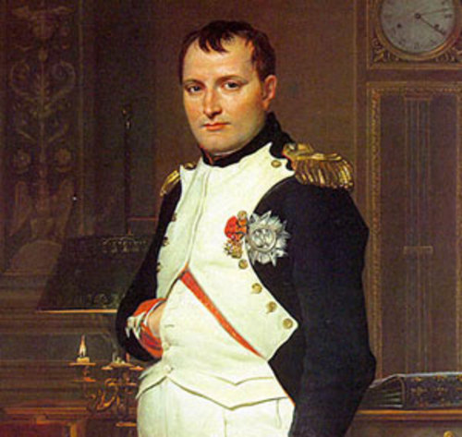
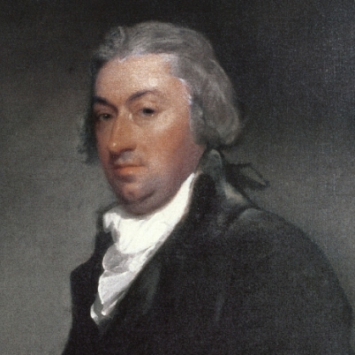
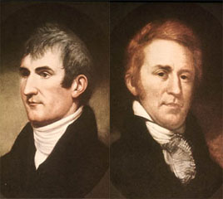
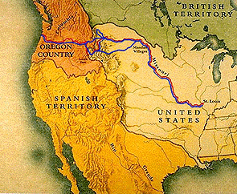
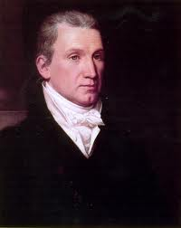
Important people
Thomas Jefferson
President of the United States who accepted the purchase
Napoleon Bonaparte
French emperor who sold the land
Robert R. Livingston and James Monroe
Sent to Napoleon to negotiate for sale of New Orleans
Lewis and Clark
Scientists sent to explore and map out the new land

Slide 11
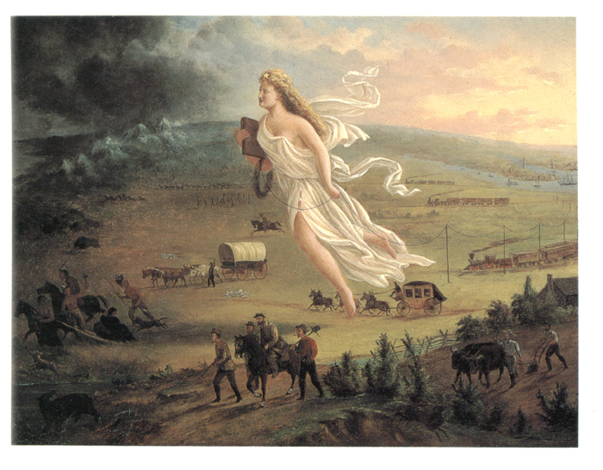
Manifest destiny
In the United States in the 19th century, Manifest Destiny was the widely held belief that American settlers were destined to expand throughout the continent.
In the New York Morning News on December 27, 1845, O'Sullivan addressed the ongoing boundary dispute with Great Britain in the Oregon Country.
“And that claim is by the right of our manifest destiny to overspread and to possess the whole of the continent which Providence has given us for the development of the great experiment of liberty and federated self-government entrusted to us.”

