Slide 1
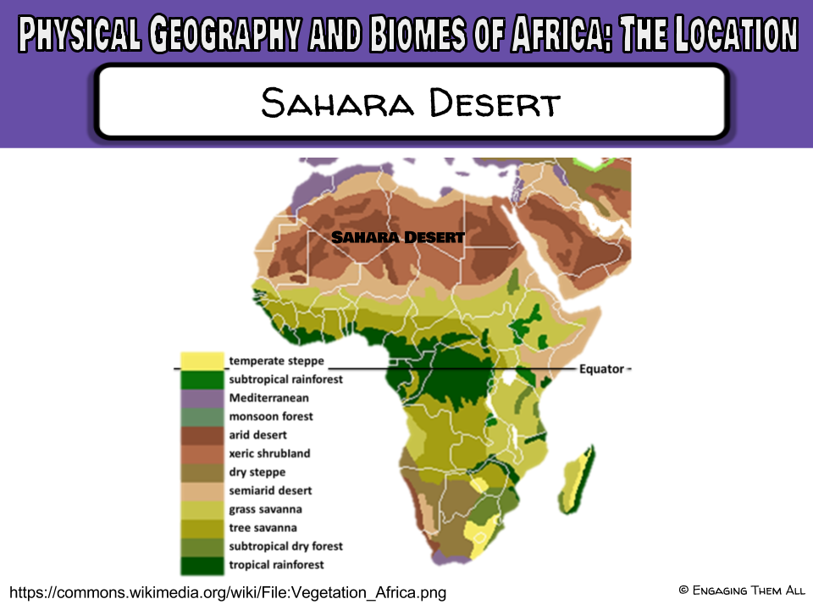
Notes:
Teachers: Click here to present the Sahara on Google Earth: https://goo.gl/EiCkbH

Slide 2
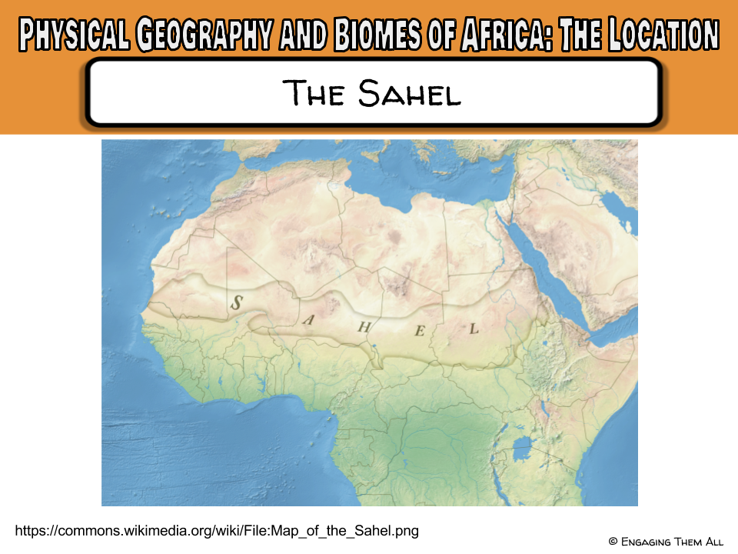

Slide 3
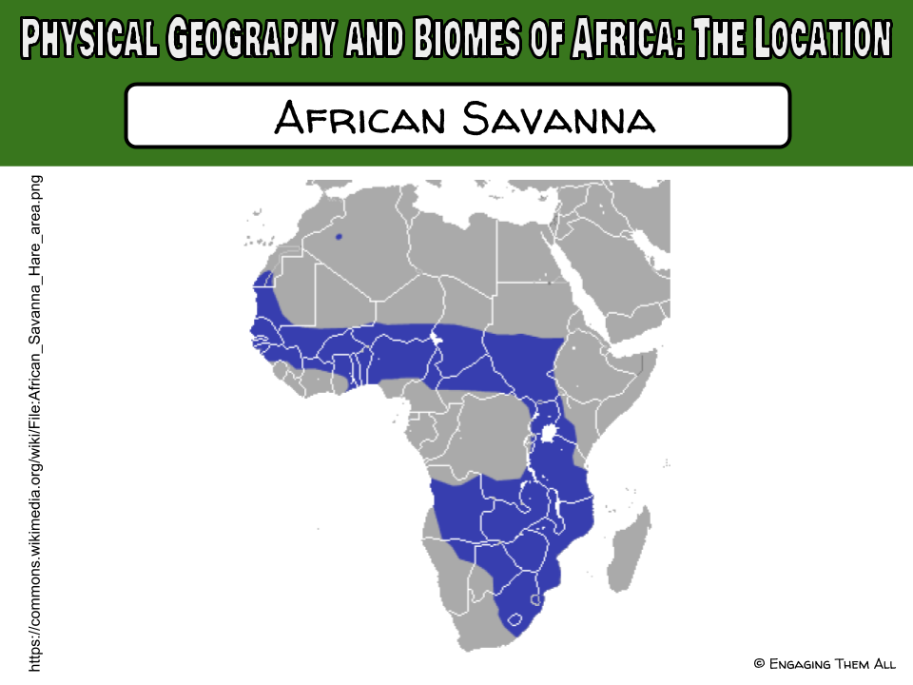

Slide 4
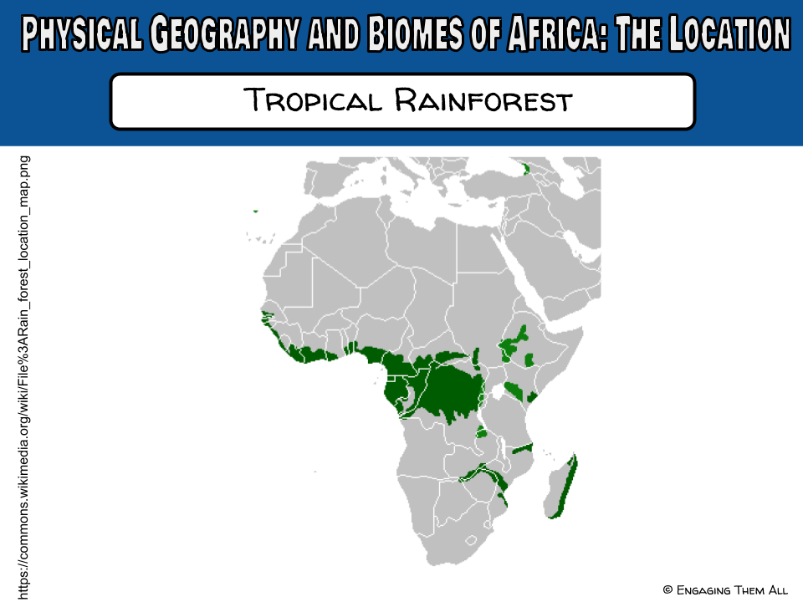

Slide 5
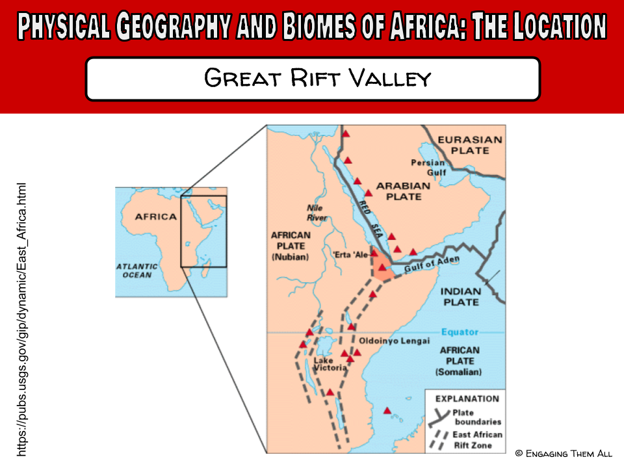

Slide 6
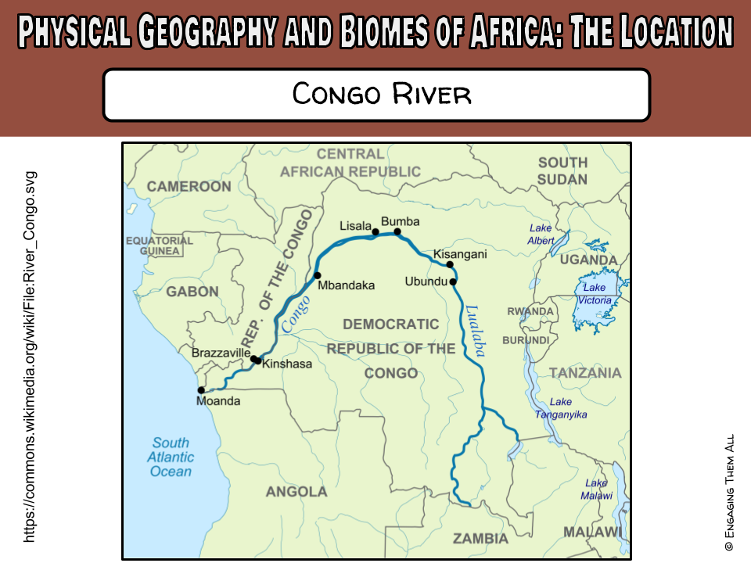

Slide 7
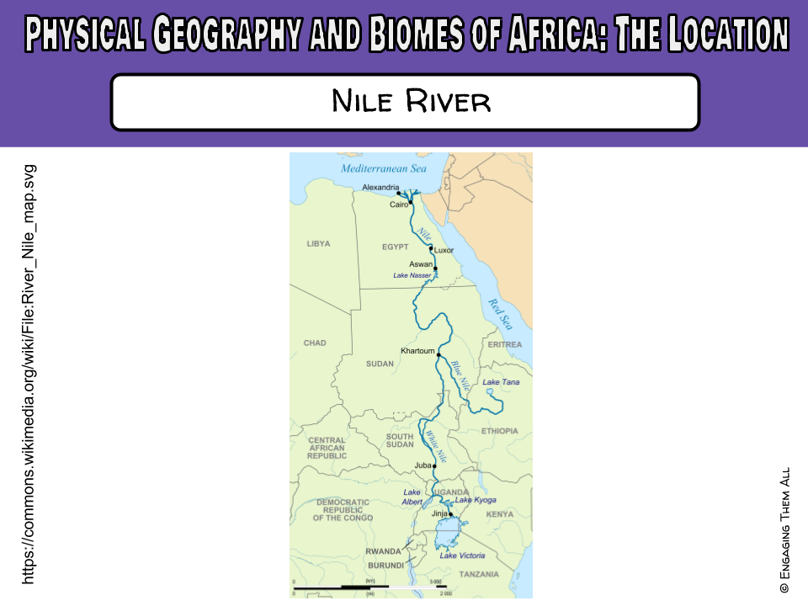

Slide 8
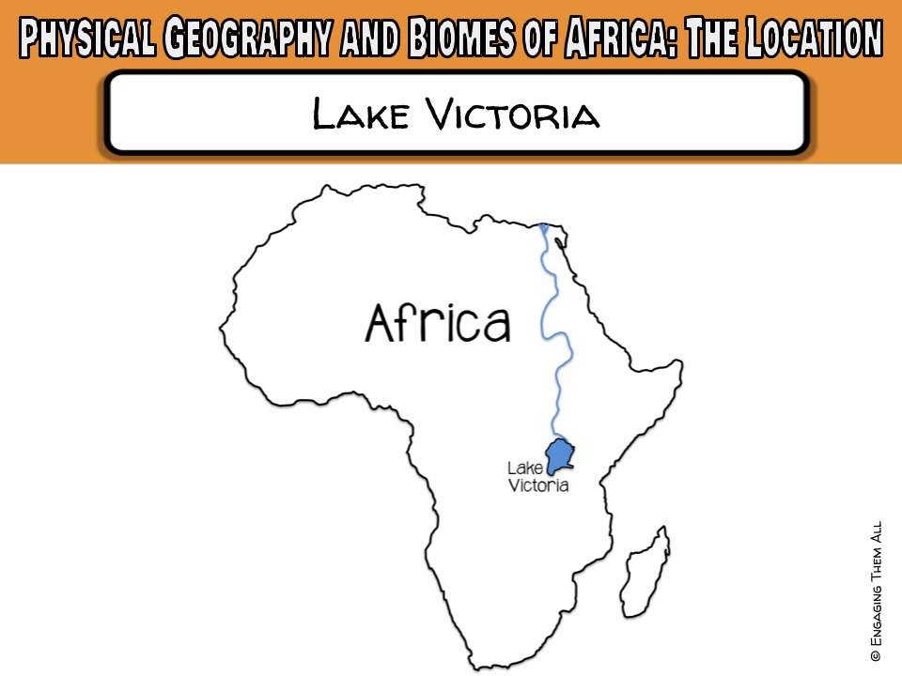
Notes:
Teachers: Click here to present it in the new Google Earth: https://goo.gl/Po4Rjg

Slide 9
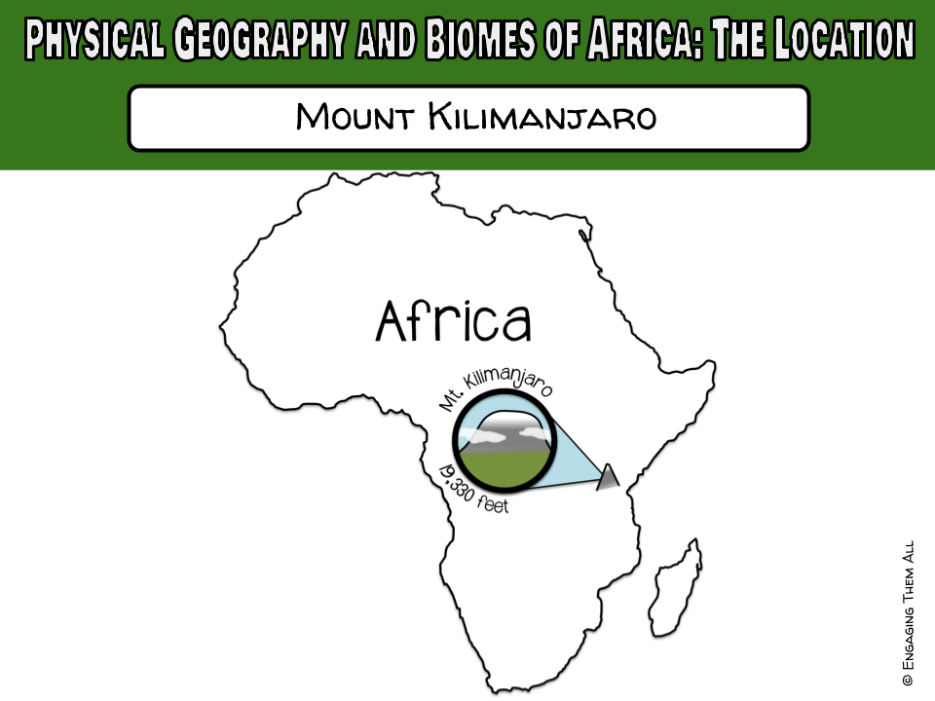

Slide 10
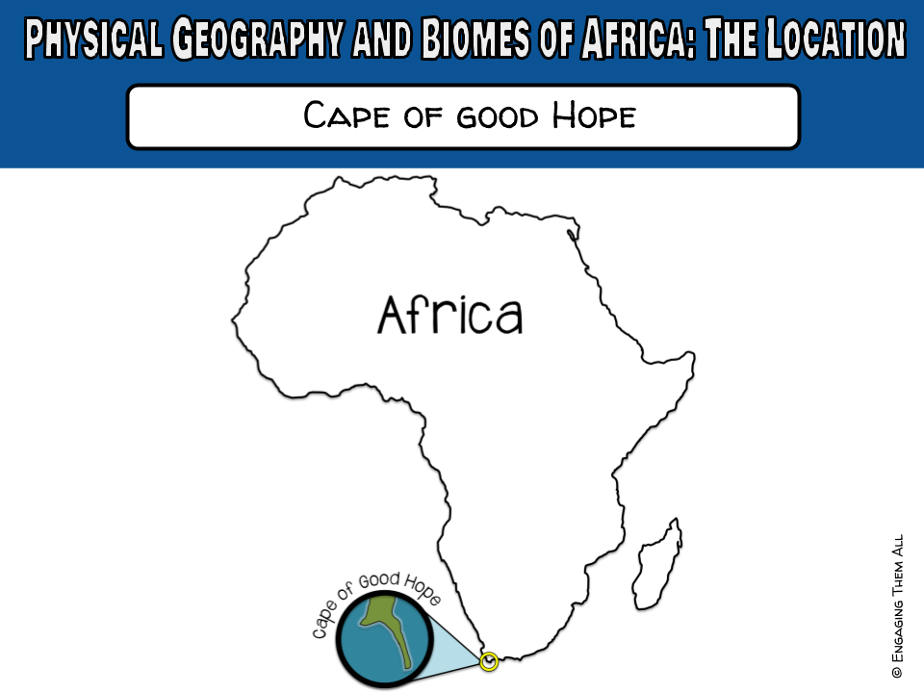

Slide 11
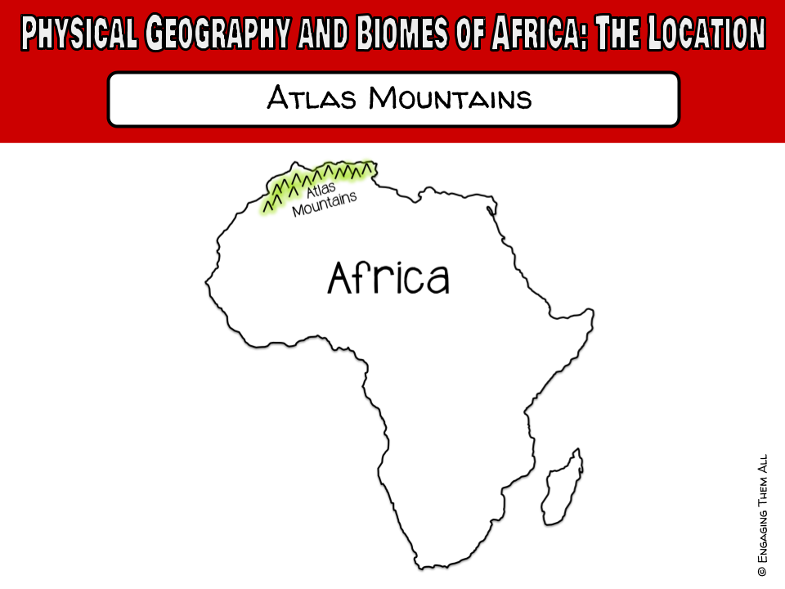

Slide 12
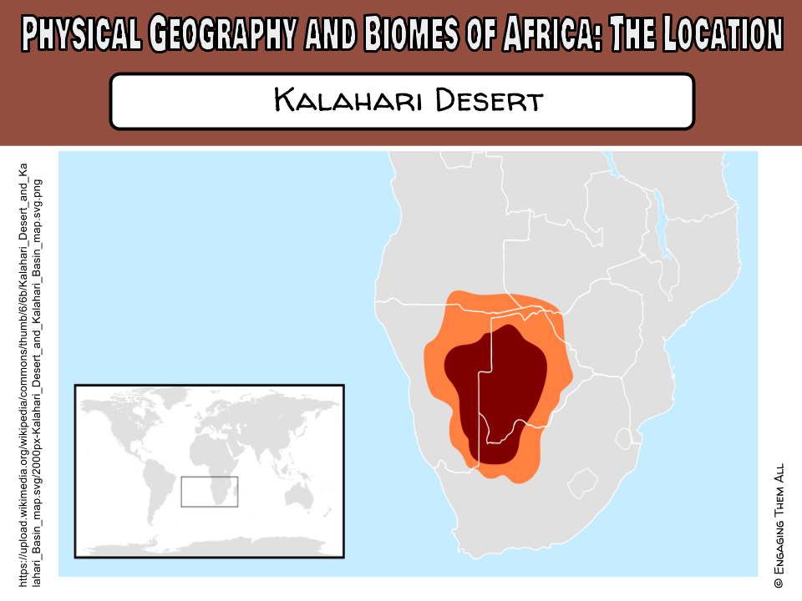

Slide 13
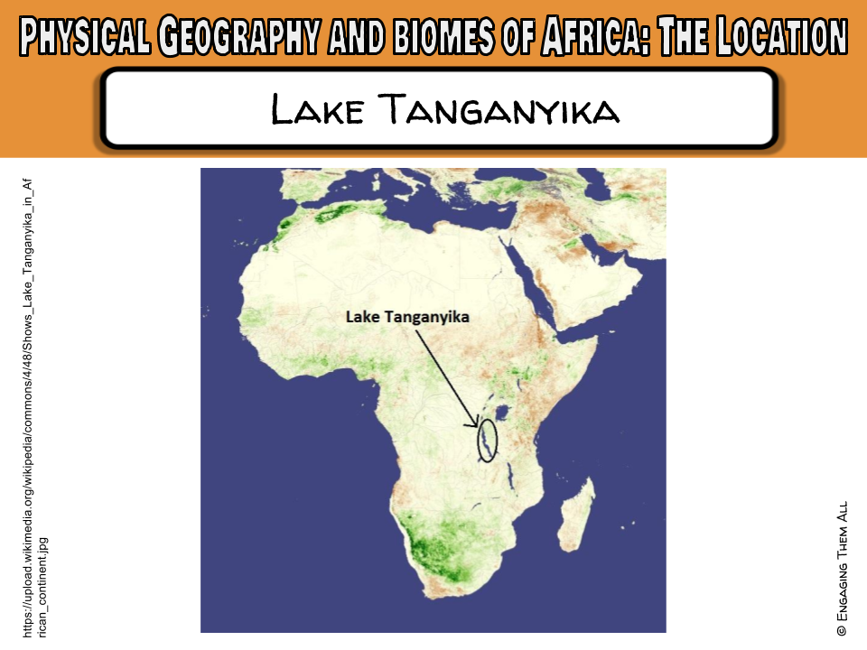
Notes:
Teachers: Click here to present it in the new Google Earth: https://goo.gl/Po4Rjg

Slide 14


Thank you so much for making this purchase! To check out more activities for middle school social studies, and content literacy, visit my Teachers pay Teachers store at:
http://www.teacherspayteachers.com/Store/Engaging-Them-All
To take a peek into my classroom and check out some FREEBIES! Visit my blog, To Engage Them All at: www.toengagethemall.blogspot.com.
Follow me on Facebook at: https://www.facebook.com/ToEngageThemAll
Check me out on Twitter: https://twitter.com/kwilkinstchr
If you have any difficulty with this product, please consider contacting me (engagingthemall@gmail.com) before leaving a rating. I am more than happy to work with you to make your purchase excellent!

